Slide 1
Chapter 6 Quantum Physics
RECAP

Slide 2
RECAP: Quantum Physics
To get full knowledge of a problem POSITION and MOMENTUM need to be known
For QUANTUM particles its Uncertain
First Postulate Introduce a parameter called ψ(x)
This is obtained as Solution of Master Equation known as SCHRODINGER EQUATION, which give FULL INFORMATION

Slide 3
RECAP: Quantum Physics
P
ΔP

Slide 4
RECAP: Quantum Physics
Postulate2: ψ*(x)ψ(x) is the probability density
For Quantum particles probability gives full information
Probability that the particle can be found in the interval dx

Slide 5
RECAP: Quantum Physics
A given wave function of the form ψ(x) =Af(x) needs to get normalized such that total Probability = 1, using the condition for NORMALIZATION
Suitable A is obtained
Dimension analysis of wavefunction in 1-D is always

Slide 6
Postulate 3
Linearity and Superposition
Let ψ₁(x) and ψ₂(x) represents the two wavefunctions of a quantum system, then the linear superposition will also be a valid wavefunction for the same quantum system.

Slide 7
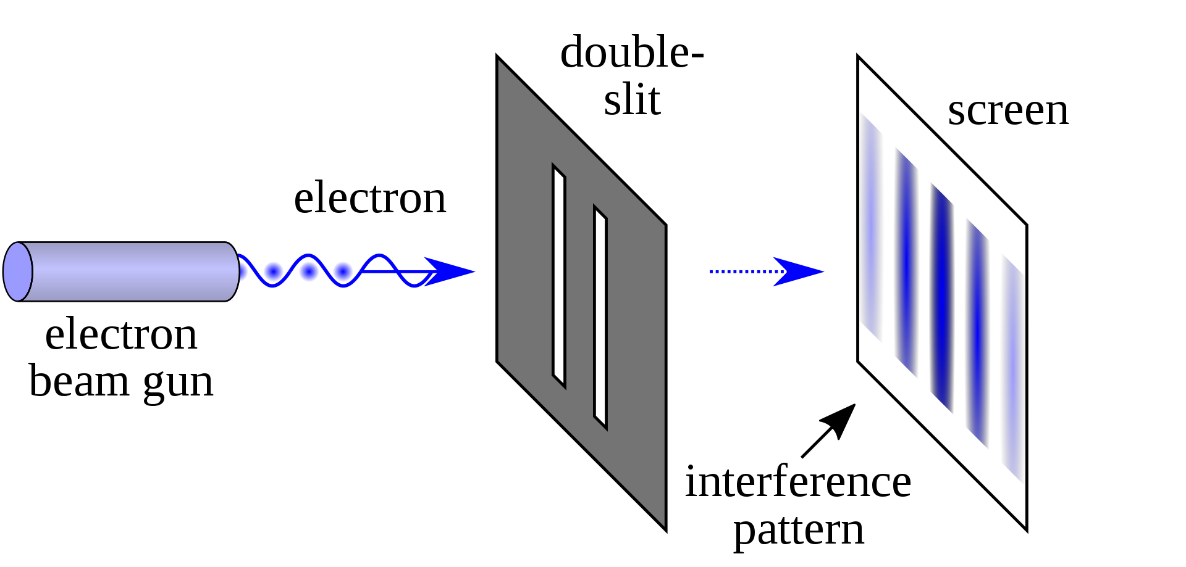
Demonstration of superposition

Slide 8
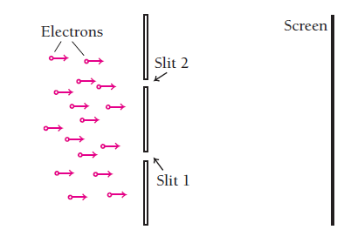
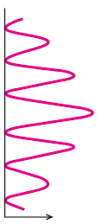
Interference term

Slide 9
Today’s Plan
Invention of a equation of motion for Wavefunction ψ:
Schrodinger Equation

Slide 10
Postulate 4
Expectation Value
OR
Average value

Slide 11
Postulate 4
Expectation values
Let ψ (x) describe the wavefunction of a quantum system, average value of the position (x) is given by the expectation value integral:
Note the difference in two expressions above, difference in representation will be clear
soon
Lets see some examples……

Slide 12
Expectation or average: no of students v/s height
20
No of students
10
5
4
4.5
5
Height

Slide 13
Expectation or average position
Probability
0.6
0.4
1m
2m
Distance (x)

Slide 14
Expectation value of position of a quantum particle
Probability that the particle can be found in the interval dx
What is the expectation value of the position of the particle ?

Slide 15
Postulate 4
Let ψ (x) describe the wavefunction of a quantum system, average value of the position (x) is given by the expectation value integral:
Expectation values

Slide 16
A particle is limited to the x axis has the wave function ψ(x) =Ax between x=0 and x=1, ψ(x) =0 elsewhere. Find the expectation value <x> of the particle’s position.
Recollect

Slide 17
Postulate 5
OPERATORS

Slide 18
Postulate 5
How to extract meaningful information from wavefunction?
To every measurable quantity (Observable) in classical mechanics there corresponds an OPERATOR in quantum mechanics.
Result of the measurement
Analogous to measurement
Eigen value equation

Slide 19
Lets see some simple examples of operator’s

Slide 20
Expectation value of observable

Slide 21
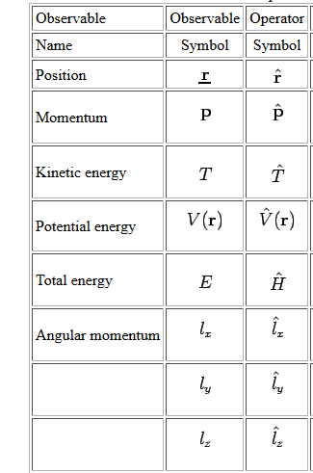
Operators
r

Slide 22
Introducing position operator

Slide 23
Expectation value of position

Slide 24
Introducing momentum operator

Slide 25
Introducing Energy operator

Slide 26
IMPORTANT GOAL
Invent a differential equation, whose solution is ψ(x,t)!
Similar to wave equation!

Slide 27
Inventing a differential equation which will solve the wavefunction ψ (x)!
Classical
Quantum Mechanical

Slide 28
Inventing a differential equation which will solve the wavefunction ψ (x,t)!
Schrodinger’s Equation (1-D)

Slide 29
Ref. Arthur Beiser, P. 168

Slide 30
Announcement
As per email received till now, following students requested for re-quiz
1. Kumari cb 33 quiz 1
2. Siyaram CS 71 quiz 1
3. Ruchir Mohan Deoraj quiz 2
4. sudhanshu 2001ee75 quiz 1
5 naman mudgal . quiz 1
6 VIVEK KUMAR SHUKLA, Roll No-2001CE65 quiz 3
7 Sudhanshu Singh quiz 1
8 Parvesh me44 quiz 1
9 Prem Kumar Ranjan Quiz 1 Roll no-2001MM22
10. Vipul Kumar Gond quiz 1
if there are anyone else i missed out reply to this e-mail by today,
Also let me know if anybody else need to know their marks, and accidently if i have forgotten to reply due to many e-mails i receive in my inbox daily.
Also students who sent scanned copies of quiz/midsem pls send an e-mail just to confirm

