Slide 1
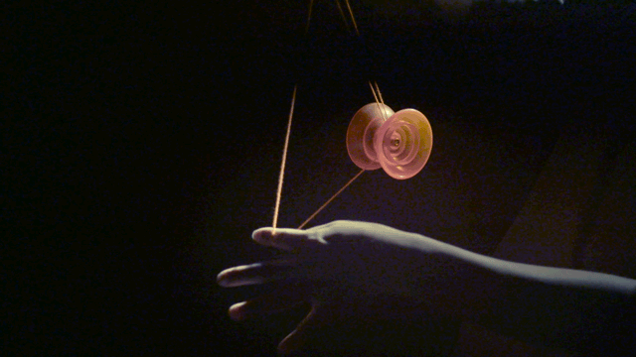
RIGID BODY IN MOTION
Chapter 4

Slide 2
Highlights of the course
Co-ordinate Systems
Quiz 1(Chapter 1)(Real time) 15 marks
Introduction to Vector Operators
Work , Energy and Conservation laws
Quiz 2 (Chapter 2&3)(Real time) 15 marks
Mid Sem Exam(Chapter 1,2,3)(real time+ Assignment) 25 marks
Rigid body in motion
Oscillations and Waves
Scan and submit answers
In 24hrs
(Problems based)
Quantum Physics

Slide 3
RECAP

Slide 4
The fact that I is a matrix means that and do not necessarily point in the same direction.
Torque and angular acceleration may not be in the same direction!!!.

Slide 5
Problem 1
y
x-y plane
(-1,0)
(1,0)
x-z plane
x
o
Consider no mass for the interconnecting rod between the two balls. Also consider these balls as point particles.
Find the Moment of Inertia Matrix
Angular momentum and Torque matrix
Physically interpret the same

Slide 6
Example 1
y
(-1,0)
(1,0)
o
x

Slide 7
Angular momentum and Torque

Slide 8
y
(-1,0)
x-z plane
(1,0)
r
x
o
F in –z direction
F in y direction
since rod is fixed in x-axis one cannot rotate with respect x-axis.

Slide 9
Problem 2
y
(1,1)
x
o
(-1,-1)
Consider no mass for the interconnecting rod between the two balls. Also consider these balls as point particles.
Find the Moment of Inertia Matrix
Angular momentum and torque matrix
Physically interpret the same for the current motion and if the system is rotated along z-axis
Find the net angular acceleration in this case also compare it, when the whole system is rotated in x-z plane

Slide 10
y
(1,1)
x
o
(-1,-1)

Slide 11
Angular momentum and Torque

Slide 12
Physical Interpretation
Torque must
Have x and y components
y
(1,1)
Force applied perpendicular to object in -z direction
x
o
(-1,-1)
Axis of rotation
A plane tilted with respect to x,y and z axis

Slide 13
Torque must
Have x and y components
y
(1,1)
Force applied perpendicular to object in -z direction
x
o
(-1,-1)
Axis of rotation
A plane tilted with respect to x,y and z axis

Slide 14
Physical Interpretation
When rotated along z-axis
y
Apply a force which has x and y components
(1,1)
x
o
(-1,-1)
Axis of rotation is z

Slide 15
Find the net angular acceleration in this case also compare it, when the whole system is rotated in x-z plane
y
Angular acceleration
y
(1,1)
F_{z} in –z direction
(- $\sqrt{2}$,0)
($\sqrt{2}$,0)
x
o
x
o
(-1,-1)
F_{z} in –z direction
y=1

Slide 16
RIGID BODY IN MOTION
Chapter 4

Slide 17
Problem 3
Find whether angular momentum and angular velocity are parallel in the below figure
y
y
x-y plane
(1,1)
(-$\sqrt{2}$,0)
($\sqrt{2}$,0)
x-z plane
x
o
x
o
(-1,-1)

Slide 18
y
x-y plane
(-$\sqrt{2}$,0)
x-z plane
($\sqrt{2}$,0)
o
x

Slide 19
y
x-y plane
(-$\sqrt{2}$,0)
($\sqrt{2}$,0)
o
x
z

Slide 20
Problem 2
y
(1,1)
o
(-1,-1)

Slide 22
Angular momentum and Angular velocity have same slopes

Slide 23
In the matrix form we may write

Slide 26
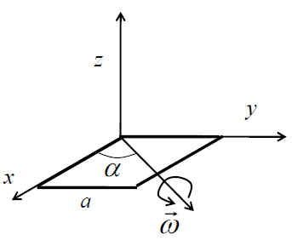
Rotation of a square plate
Problem 4
Consider rotation of a square plate of side a and mass M about an axis in the plane of the plate and making an angle α with the x-axis.
What is the angular momentum L about the origin?
For what angle L and ω becomes parallel?
For square plate when the moment of inertia tensor becomes diagonal?

Slide 27
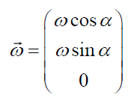
Rotation of a square plate
What is the angular momentum L about the origin?

Slide 28
Rotation of a square plate
What is the angular moment L about the origin?

Slide 30
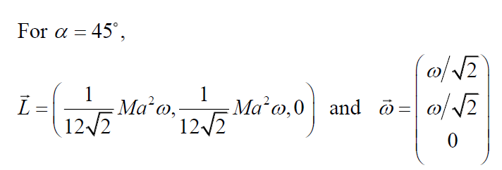
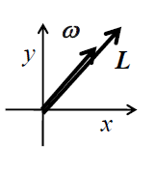
Rotation of a square plate
(b) For what angle L and ω becomes parallel?

Slide 31
Rotation of a square plate
(b) For what angle L and ω becomes parallel?

Slide 32
Rotation of a square plate (Implications)
Z
X
ω
L and ω are parallel!

Slide 33
Concept behind the problem
Z
Z
X
X
PHYSICAL NATURE OF ROTATION IS SAME AS IN 45 DEGREE ROTATION
ω
Use of symmetry will ensure diagonal Moment of Inertia tensor

Slide 34
Principal Axis
Cumbersome!
Principal axes are the orthogonal axes for
Which [I] is diagonal
Z
X
Y

Slide 35
Note!
Whenever ω is parallel to L, choosing the corresponding direction of rotation as co-ordinate axis will be the principal axes.
Let’s recollect the problems we did………

Slide 36
Whenever ω is parallel to L, choosing the corresponding direction of rotation as co-ordinate axis will be the principal axes
y
x-y plane
(-1,0)
(1,0)
x-z plane
x
o

Slide 37
Whenever ω is parallel to L, choosing the corresponding direction of rotation as co-ordinate axis will be the principal axes
y
(1,1)
x
o
(-1,-1)

Slide 38
Whenever ω is parallel to L, choosing the corresponding direction of rotation as co-ordinate axis will be the principal axes
y
x-y plane
(-$\sqrt{2}$,0)
($\sqrt{2}$,0)
x-z plane
o
x

Slide 39
Whenever ω is parallel to L, choosing the corresponding direction of rotation as co-ordinate axis will be the principal axes
Z
Z
X
X
ω

Slide 40
Is Moment of Inertia a Scalar? Vector?
Or …. ????
Tensor

Slide 41
Tensor
Tensor represents a physical entity which may be characterized by magnitude and multiple directions simultaneously.
The rank of a tensor is defined by the number of directionality required to describe a component of it.

Slide 42
Tensor
The rank of a tensor is defined by the number of directionality required to describe a component of it.
Temperature, Mass, Potential
‘0’
SCALAR
VECTOR
Force, Velocity, Torque
‘1’

Slide 43
Tensor
Moment of Inertia
‘2’
Torque applied in a given direction need not guarantee angular acceleration also in same direction, rather it can have components in 2 other direction’s simultaneously as well. This is due to coupling between two directions ( example Z-X, Z-Y ……etc). This coupling is induced via Moment of Inertia Tensor
The rank of a tensor is defined by the number of directionality required to describe a component of it.
Rank 2 Tensor represents a physical entity which may be characterized by magnitude and bi-directionality.

Slide 44
Rank of a tensor
0 | Scalar
1 | Vector
2 | Tensor of rank 2 (Dyadic)
Higher orders | Higher rank tensors

Slide 45
No Tutorial Tomorrow

Slide 46
Find the (a) Moment of Inertia matrix and (b) angular momentum of a cube with Side length L and mass M, with co-ordinate axis parallel to the edges of the cube and the origin at a corner.
(1)
Z
L
L
L
X
Y

Slide 47
Moment of Inertia Tensor
(a)
Z
L
L
L
X
Y

Slide 48
Moment of Inertia Tensor

Slide 49
Moment of Inertia Tensor

Slide 50
Angular momentum vector
(b)

Slide 51
(2)
Calculate the Moment of Inertia matrix of a cube when the origin is shifted to the center of the cube.
Intuitively find the principal axis of rotation
Z
L
L
L
X
Y

Slide 52
Moment of Inertia Tensor

Slide 53
Moment of Inertia Tensor

Slide 54
(2)
b. Intuitively find the principal axis of rotation
If the origin is chosen at the centre and co-ordinate axis as shown in the figure, the MI tensor will be diagonal and then the coordinate is symmetrically selected. Thus this will be one of the principal axis.
Z
L
L
L
X
Y

