Slide 1
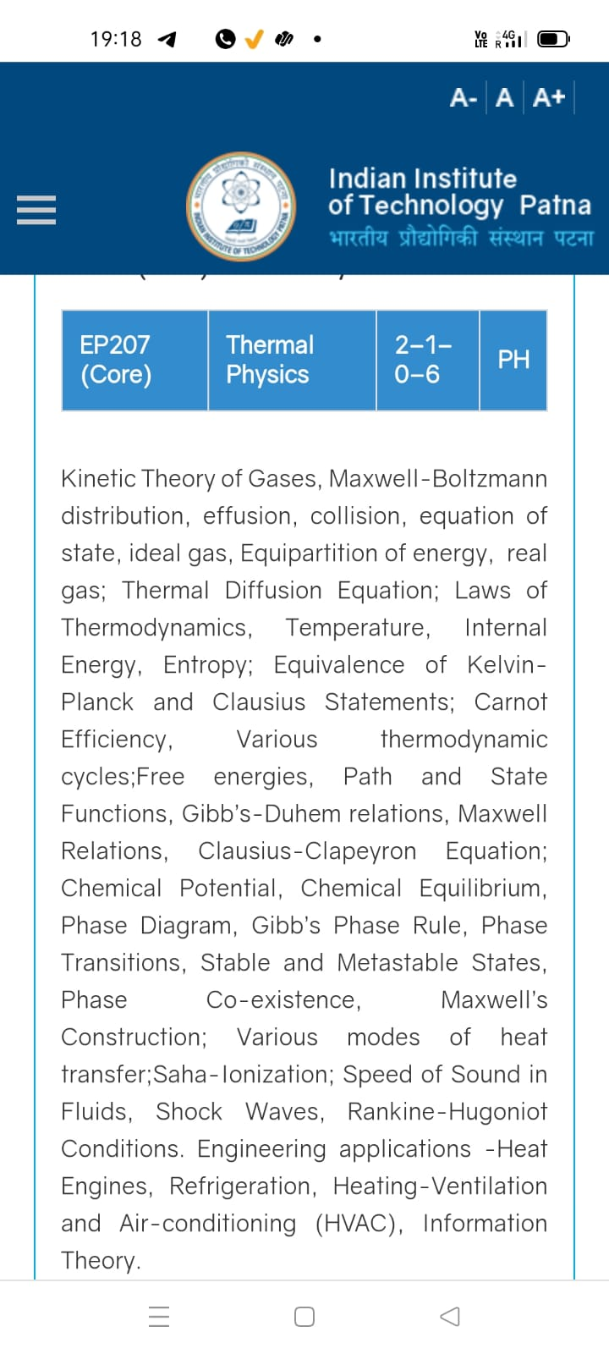
Season 1, Lecture 11 (S1,L11):
Thermal Diffusion and Effusion

Slide 2
Roll No | Name | P/A
2101PH03 | ABHINAV T V
2101PH05 | AMAN KUMAR
2101PH06 | AMAR KUMAR
2101PH07 | AMOY ASHESH
2101PH08 | ANIKET RAJ
2101PH09 | ANIKET SAWATE | A
2101PH11 | ARYAN SINGH SISODIYA | A
2101PH12 | AYESHA KHAN
2101PH13 | AYUSH SINGH
2101PH16 | TANISHK KADAM JEEVAN
2101PH17 | KANISHK SINGH SOLANKI | A
2101PH19 | MEESALA MAHESH | A
2101PH21 | N AJAY
2101PH22 | NITISH KUMAR
2101PH24 | RAJAT CHANDNA

Slide 3
Roll No | Name | P/A
2101PH27 | S RAMAKRISHNA
2101PH28 | SALOCHANA
2101PH29 | SANJANA KUMARI
2101PH30 | SHILPA KANJILAL
2101PH32 | VISHESH SAHU | A
2101PH18 | Elisha Joel
2101PH14 | Pavan
2101PH04 | Abhishek Shaw | A
2101ph15 | Chandan Kumar | A

Slide 4
Concept of Diffusion and Effusion: Kinetic theory of gases

Slide 5
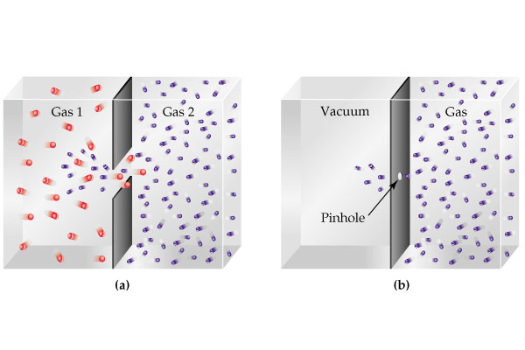

Slide 6
This is called as a “steady state” condition
Plot concentration as a function of x

Slide 8
Plot

Slide 9
Note:
Using variable separable method one can find the solution as

Slide 10
Plot

Slide 11
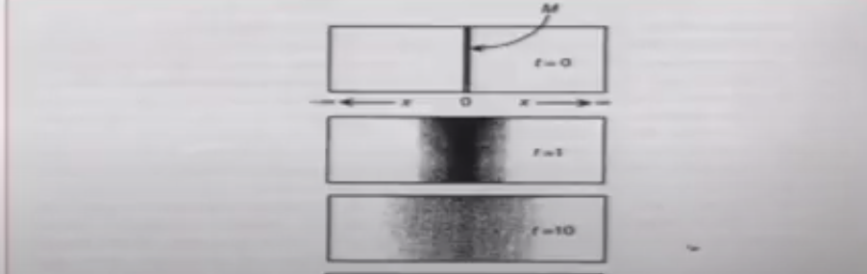

Slide 12
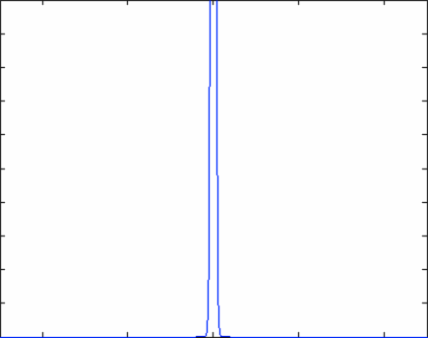
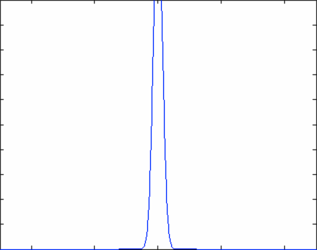

Slide 13
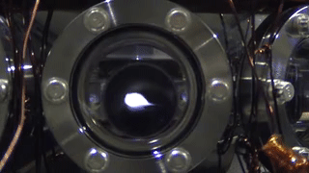
Atomic cloud diffusion in Quantum Technology

Slide 14
v
v

Slide 15


Slide 16
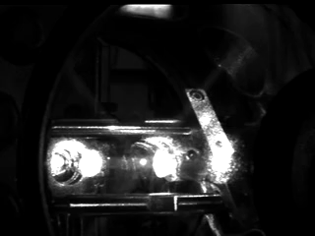

Slide 17
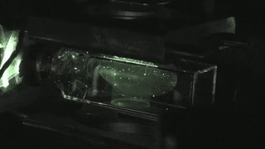

Slide 19
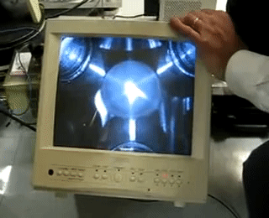

Slide 21
v
a
Non invasive temperature
measurement
a+vt
a+vt’

Slide 22
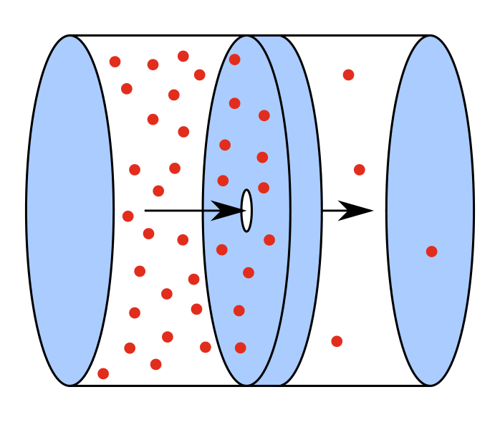
Effusion
Effusion
Effusion occurs through an orifice smaller than the mean free path of the particles in motion

Slide 23
Gas in left chamber is under equilibrium

Slide 24
To maintain gas in left chamber is under equilibrium
Ensures little or no collisions near the opening hence the equilibrium is maintained

Slide 25
Equilibrium is not disturbed
Under the above condition escape of molecules through hole is called as EFFUSION
OR
EFFUSION occurs through an orifice smaller than the mean free path of the particles in motion

Slide 26
dA

Slide 27
Flux of molecules
dA

Slide 28
Volume of slanted cylinder
dA

Slide 30
HOME WORK
Distribution function
Maxwell Boltzmann speed distribution

Slide 31
Mid-sem

Slide 32
Introduction to Thermodynamics
A revision

Slide 33
Macroscopic approach
Does not probe system at molecular level
Thermodynamic variables P,V,T
System and rest of universe (reservoir: Infinite heat capacity)
System is separated by a wall

