Slide 1
Lecture 6 Surface and Volume Integral: Practice Problems

Slide 2
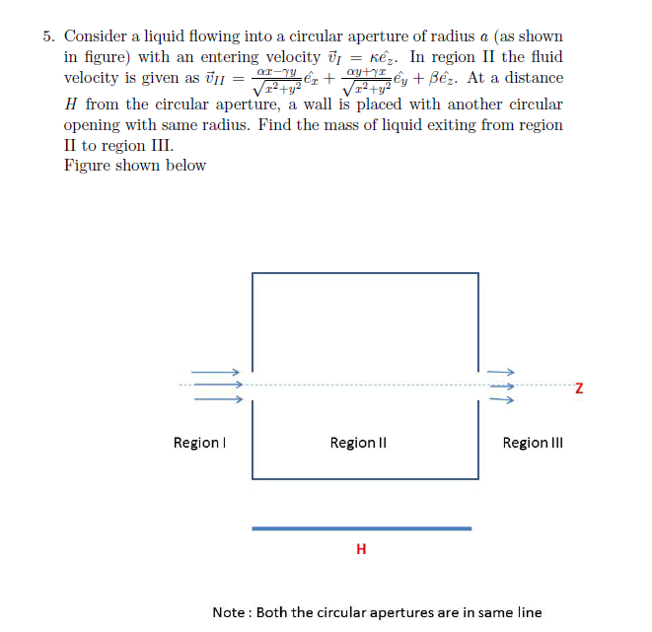

Slide 3
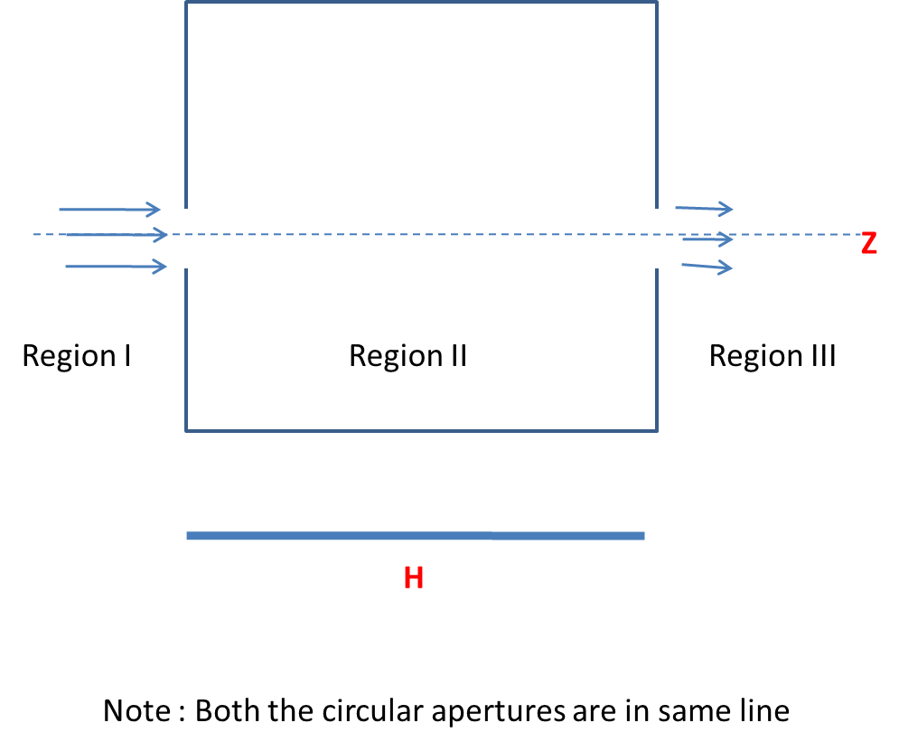
y
z
MASS OF LIQUID EXITING FROM REGION II TO REGION III =
MASS OF LIQUID ENTERING FROM THE REGION I –
MASS OF FLUID FROM THE SURFACE OF AN IMAGINARY CYLINDER OF RADIUS a AND LENGTH H
x

Slide 4
MASS OF LIQUID ENTERING FROM THE REGION I
Mass of liquid entering per elemental area da per unit time =
σv.da
$$dρ$$
$$ρdφ$$
I
dφ
II
III
z

Slide 5
MASS OF FLUID LOST FROM THE SURFACE OF AN IMAGINARY CYLINDER OF RADIUS a AND LENGTH H
$$dz$$
a$dφ$
I
a
dφ
II
III
z

Slide 6
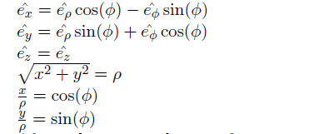

Slide 8
ρ
R
Ф = 0 to 2π
ρ = 0 to Rz/H
Z = 0 to H
z
H
ρ= SLOPE *Z
SLOPE = R/H

