Slide 1
M. Sc
 |  |  |  | L2 | L3 | L4
l3 | Harish | . | 2312PH12 | p | P | p | p | p
2 | Palak | . | 2312PH34 | p | P | p | p | p
3 | Rafik | Amin | 2312PH20 | p | P | p | p | p
4 | Srijan | Chatterjee | 2312PH29 | p | P | p | p | a
5 | Priyanka | Choudhary | 2312PH35 | p | P | p | p | a
6 | Rupak | Das | 2312PH22 | p | P | p | p | p
7 | Dhrupad | Deka | 2312PH10 | p | P | p | a | p
8 | Sachin | Grewal | 2312PH23 | p | P | p | p | p
9 | Indrajit | Halder | 2312PH32 | p | P | p | p | p
10 | Ankur | Jyoti Gogoi | 2312PH03 | a | P | p | p | p

Slide 2
M. Sc
 |  |  |  | L2 | L3 | L4
11 | Harsimran | Kaur | 2312PH14 | p | P | p | p | p
12 | Mohd Faiz | Khan | 2312PH17 | p | P | p | p | p
13 | Mohit | Kumar | 2312PH18 | a | A | p | p | p
14 | Rahul | Kumar | 2312PH21 | p | P | p | p | p
15 | Devendra | Kumar Kanwar | 2312PH09 | p | P | p | p | p
16 | Sashank | Kumar Pandey | 2312PH24 | p | P | a | p | p
17 | Ayan | Mandal | 2312PH06 | p | P | p | p | p
18 | Dipankar | Mandal | 2312PH11 | p | P | p | p | p
19 | Md Ayan | Nawaz | 2312PH16 | a | A | p | p | p
20 | Juwairiya |  |  |  |  | a | a | p

Slide 3
M. Sc
20 | Shubham | Pal | 2312PH27 | p | P | p | p | p
21 | Aniket | Rathi | 2312PH02 | p | P | p | p | p
22 | Soumya | Santra | 2312PH28 | p | P | p | p | p
23 | Burhan | Shabir | 2312PH08 | p | P | p | p | p
24 | Priya | Sharma | 2312PH19 | p | P | p | p | p
25 | Shriya | Shukla | 2312PH26 | p | A | p | p | p
26 | Niharika | Verma | 2312PH33 | p | P | p | p | p
27 | Annu | Yadav | 2312PH04 | p | P | p | p | p
28 | juwariya |  |  | p | a

Slide 4
Ph. D
 |  |  | L3 | L4 | L5
niladri |  |  | p | P | p | p | p
debangana |  |  | p | P | p | p | p
omega |  |  | a | A | p | p | p
shubham |  |  | p | P | p | p | p
juwariya |  |  | p | a

Slide 5

Quantum Technology using Quantum Optics
Dr. Raghavan K Easwaran
Associate Professor
Indian Institute of Technology Patna

Slide 6
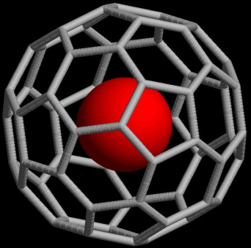
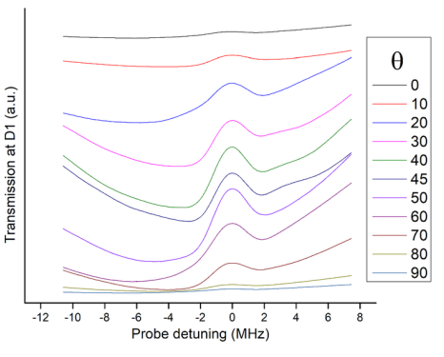
4. EIT in Engineered atoms
Title: Theoretical study on encapsulated Rb atom inside a C-60 cage for Quantum Technology
application using Electromagnetically Induced Transparency Protocol
Principal Investigator: Dr. Raghavan K . Easwaran
Duration: 3 years (2023) (Sanctioned)
Value: 26.97 Lakh
Funding Agency: SERB, CRG, DST, Govt of India
Quantum Technology
Research
Breadth of my research work
Towards Quantum Memory (QM)
Ultracold atoms
Engineered atoms

Slide 7
Quantum Technology
Quantum Memory (QM) using EIT protocol
Quantum Memory using Structured light
Higher order and broad band QM
Towards wireless QM for long distance/Satellite Quantum Communication
Under water QM for long distance Quantum Communication
Encapsulated Rb inside C-60 cage for QM

Slide 8
Quantum Memory (QM)
Stationary QuBit
i.e QUANTUM MEMORY
(Eg an atom)
Flying QuBit
(photonic quantum state)
Flying QuBit
(photonic quantum state)
storage
read-out
LIGHT
(Quantum Information)
LIGHT
(Quantum Information)
ATOM + LIGHT
Dressed atomic and light quantum states
RESEARCH
WORK
EIT (Electromagnetically Induced Transparency)

Slide 9
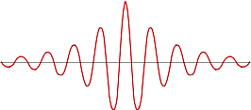
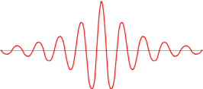
Motivation and need for Broadband Atomic EIT

Slide 10
A
QM
QM
B

Slide 11
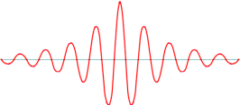
Motivation and need for Broadband Atomic EIT
.
.
.
.
.
.
.
.

Slide 12
Platform | Species | Mechanism | Bandwidth | Efficiency | Storage Time
Warm atomic gases | ⁸⁷Rb [1] | EIT | 660 MHz | 17 % | 50 ns
 | ⁸⁷Rb [2] | Raman | 77 MHz | 82 % | 170 ns
Cold atomic gases | ⁸⁷Rb [3] | EIT | 0.67 MHz [9] , 5 MHz [10] | 92% [10] | 220 ms
Rare-earth-ion doped crystal | ¹⁵¹Eu³⁺ : Y₂SiO₅ [4] | Hybrid-AFC | 1.5 MHz | 7.4 % | 20 ms
Color Centers in diamond | NV [5] | Absorptive | 12 MHz | 1 % | > 10 s
Single atoms and ions | ⁸⁷Rb [6] | Raman | - | 22 % | 100 ms
 | ¹⁷¹Yb⁺ [7] | Raman | 19.4 MHz | 10.1 % | 1.022 ms
[1] Wolters J, Buser G, Horsley A, Béguin L, Jöckel A, Jahn J-P, Warburton R J and Treutlein P 2017 Simple atomic quantum memory suitable for semiconductor quantum dot single photons Phys. Rev. Lett. 119 060502.
[2] Guo J, Feng X, Yang P, Yu Z, Chen L, Yuan C-H and Zhang W 2019 High-performance Raman quantum memory with optimal control in room temperature atoms Nat. Commun. 10 1.
[3] Yang S-J, Wang X-J, Bao X-H and Pan J-W 2016 An efficient quantum light–matter interface with sub-second lifetime Nat. Photon. 10 381.
[4] Ortu A, Holzäpfel A, Etesse J and Afzelius M 2022 Storage of photonic time-bin qubits for up to 20 ms in a rare-earth doped crystal npj Quantum Inf. 8 29.
[5] Yang S et al 2016 High-fidelity transfer and storage of photon states in a single nuclear spin Nat. Photon. 10 507.
[6] Körber M, Morin O, Langenfeld S, Neuzner A, Ritter S and Rempe G 2018 Decoherence-protected memory for a single-photon qubit Nat. Photon. 12 18.
[7] Kobel P, Breyer M and Köhl M 2021 Deterministic spin-photon entanglement from a trapped ion in a fiber Fabry–Perot cavity npj Quantum Inf. 7 1.
[8] Mol, J.-M., Esguerra, L., Meister, M., Bruschi, D. E., Schell, A. W., Wolters, J., & Wörner, L. (2023). Quantum memories for fundamental science in space. Quantum Science and Technology, 8(2), 024006. https://doi.org/10.1088/2058-9565/acb2f1.
[9] Chen et al. Phys. Rev. Lett., 110, 083601, (2013) Cold Atomic Medium
[10] Hsiao et al. Phys. Rev. Lett., 120, 183602, (2018) Cold Atomic Medium

Slide 13
“Electromagnetically Induced Transparency (EIT)” based Quantum Technology in Quantum Optics & advances

Slide 14
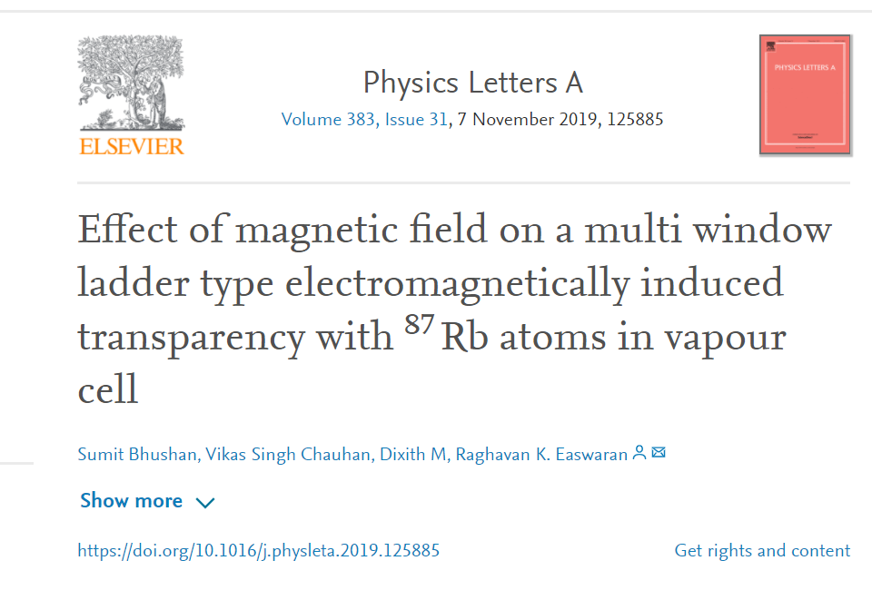
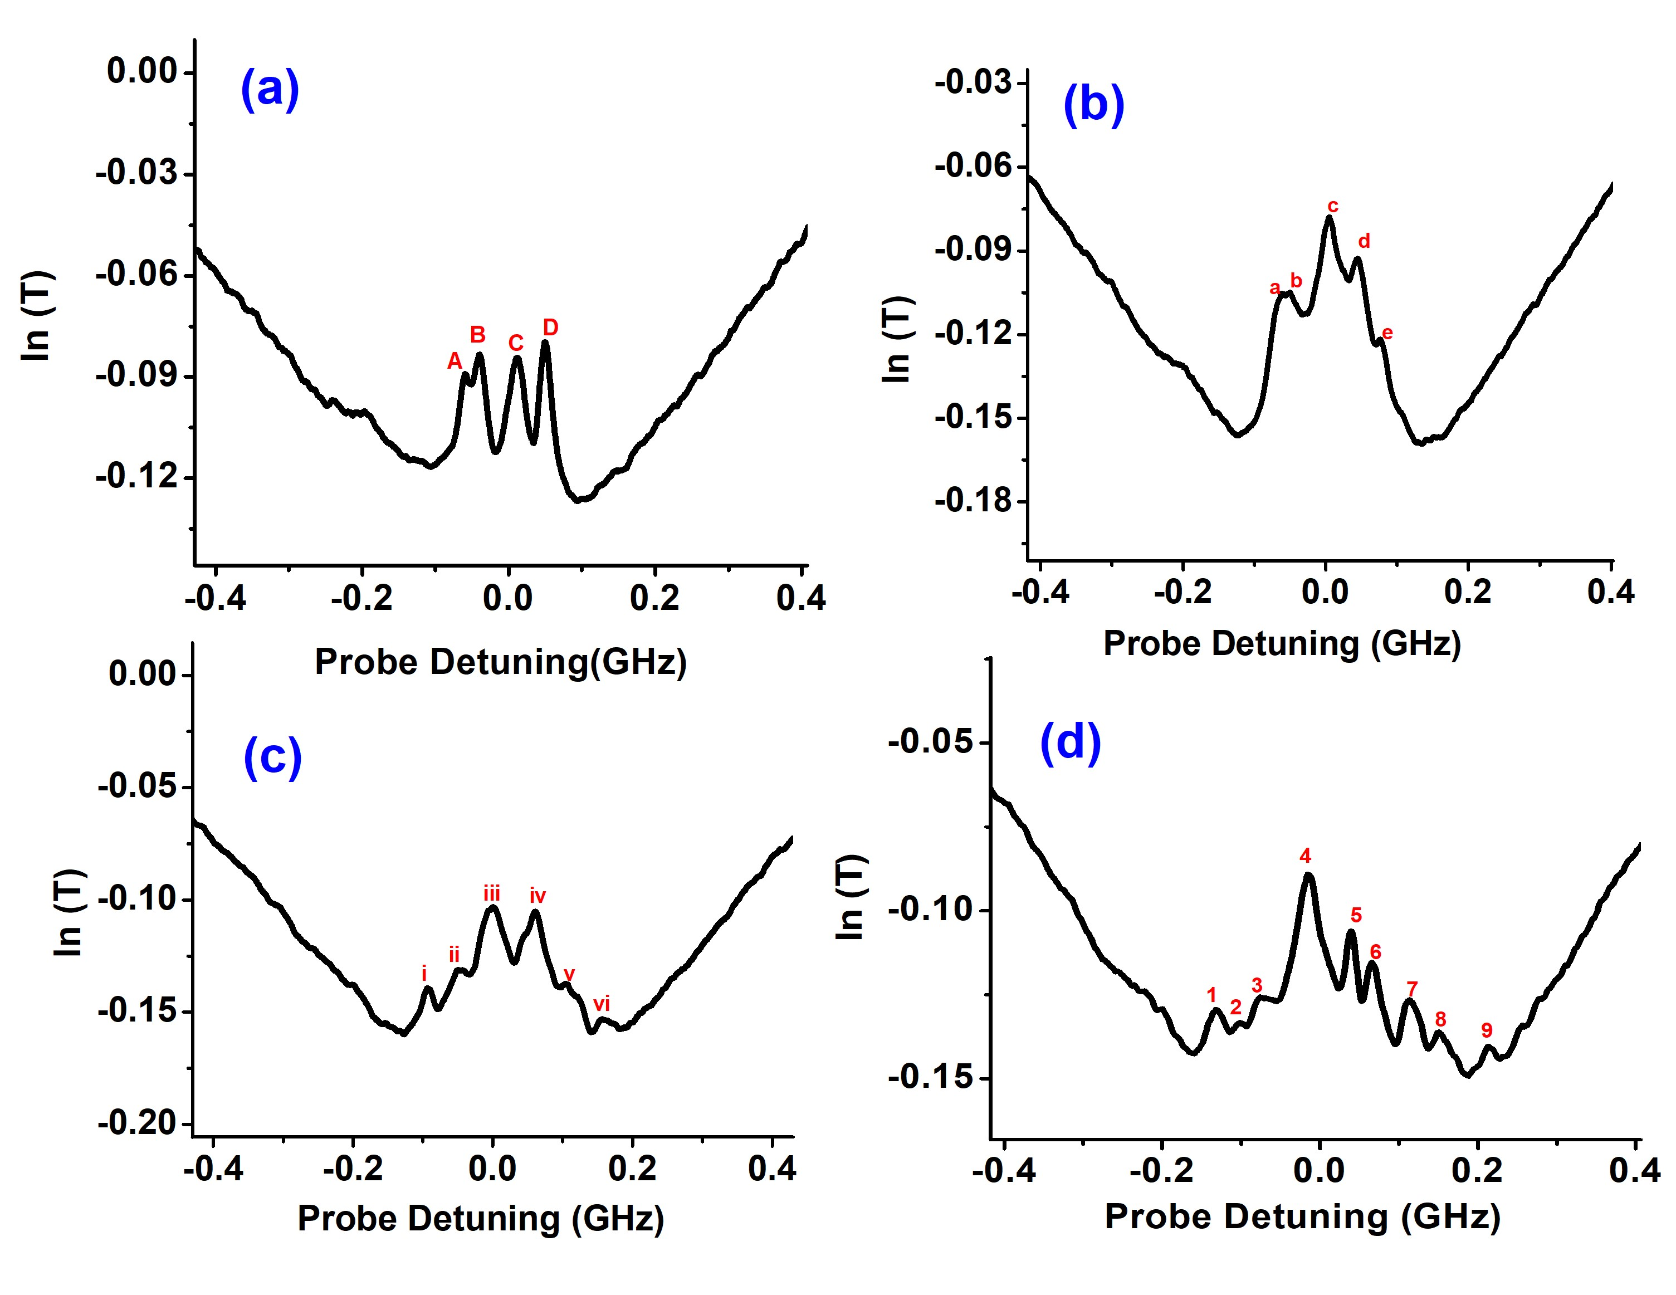
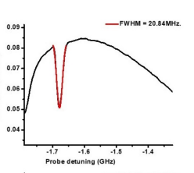
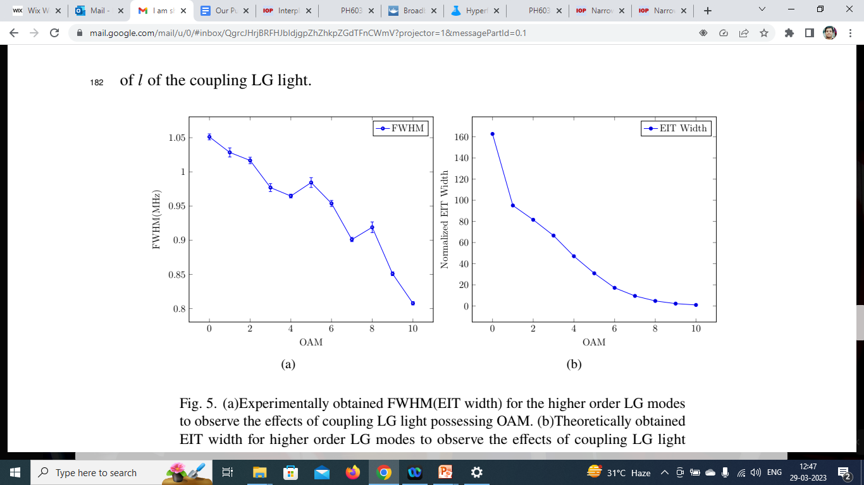
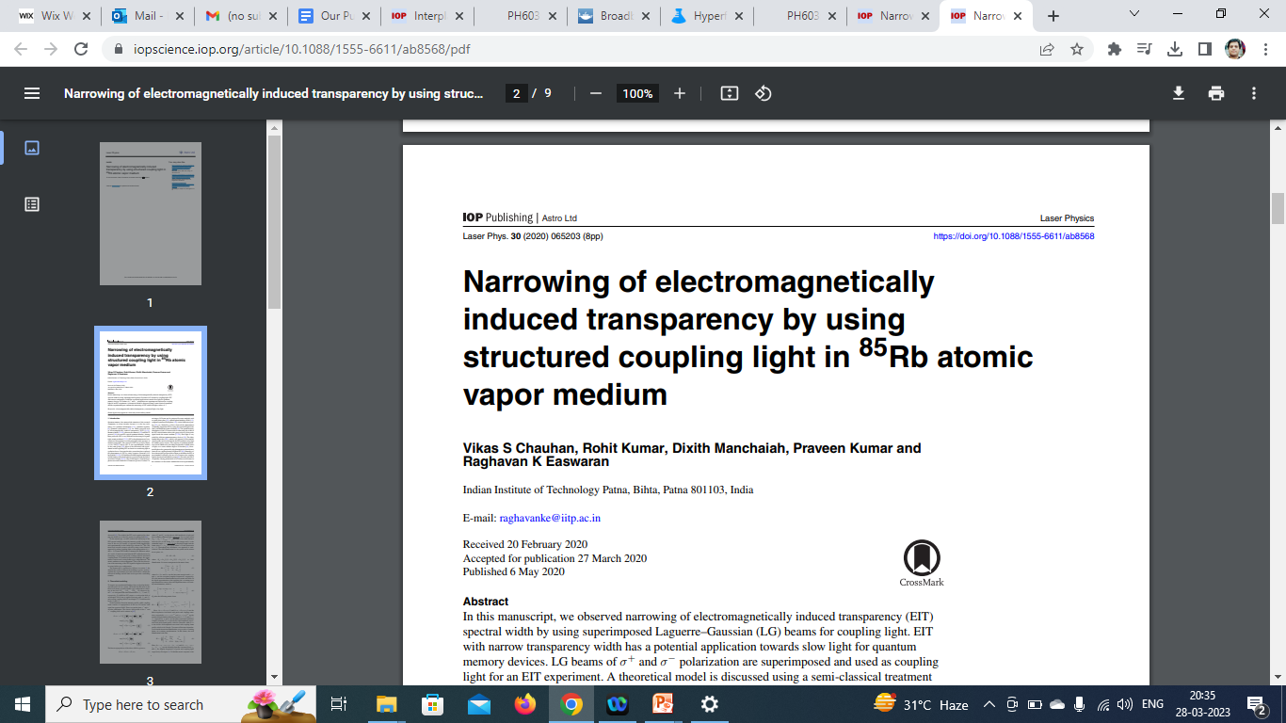
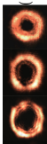
Electromagnetically Induced Transparency (EIT)
Novelty
• Number of EIT transparency peaks in presence of magnetic field is 9 at 18 Gauss.
• Wide scale tunability can be achieved with respect to spectral positions of the peaks.
• EIT based atomic memory is shown to be competent with other multi mode protocols.
1. EIT in Presence of Magnetic field
More number probe pulses can be stored and processed in parallel
Slow light using EIT
Slow light using EIT
Atomic gas sample
Example : Rb atoms
ɑ
Im(χ)
Detuning, δ
1
2
1
2
f₀
n
Re(χ)
.
.
.
.
-4
-2
0
2
4
δ_{p}
Detuning δ
More signals could be stored by applying magnetic field
2. Effects of Structured light
Multiple frequency probe channels for communication
1: Probe, 2: Coupling
Multiple frequency probe pulses could be stored in same Vapor cell using magnetic fields
Multiple frequency or Multi window EIT
Example 2 frequencies,,,,,,it could be more,,,,
We observed narrowing
of EIT spectral
width by
using LG
beams for coupling light.
EIT with narrow transparency width has potential application
towards slow light for quantum memory devices. Very low group velocities could be achieved
Novelty

Slide 15
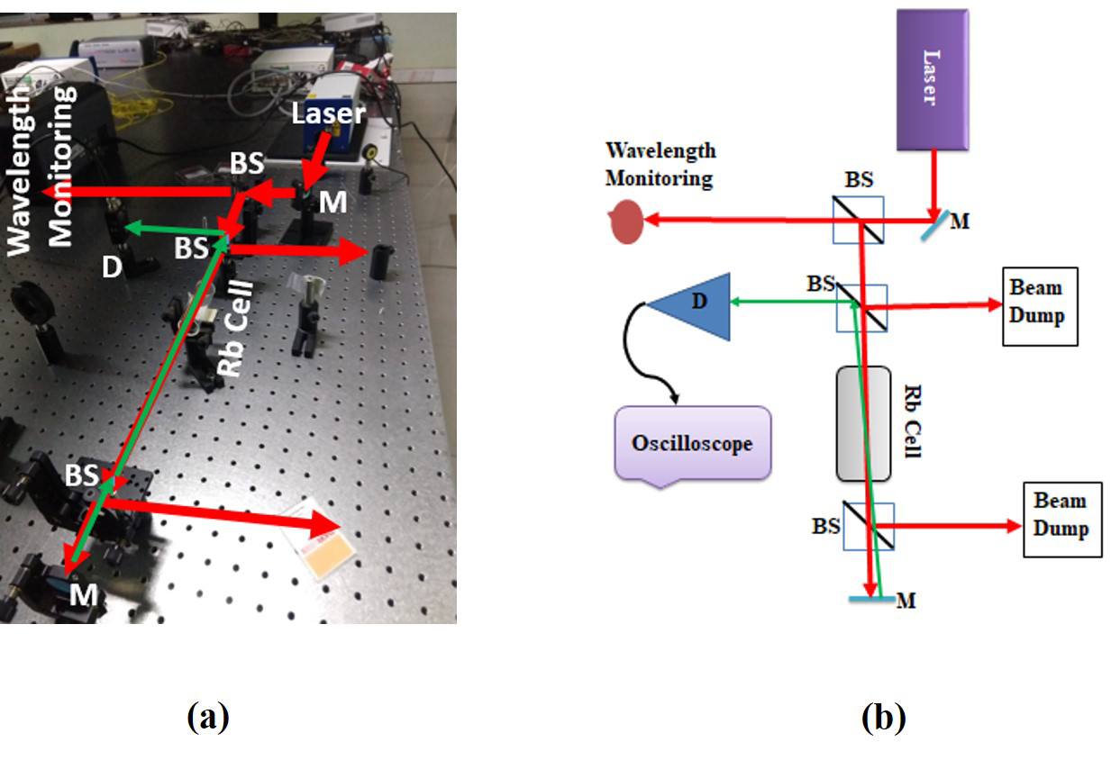
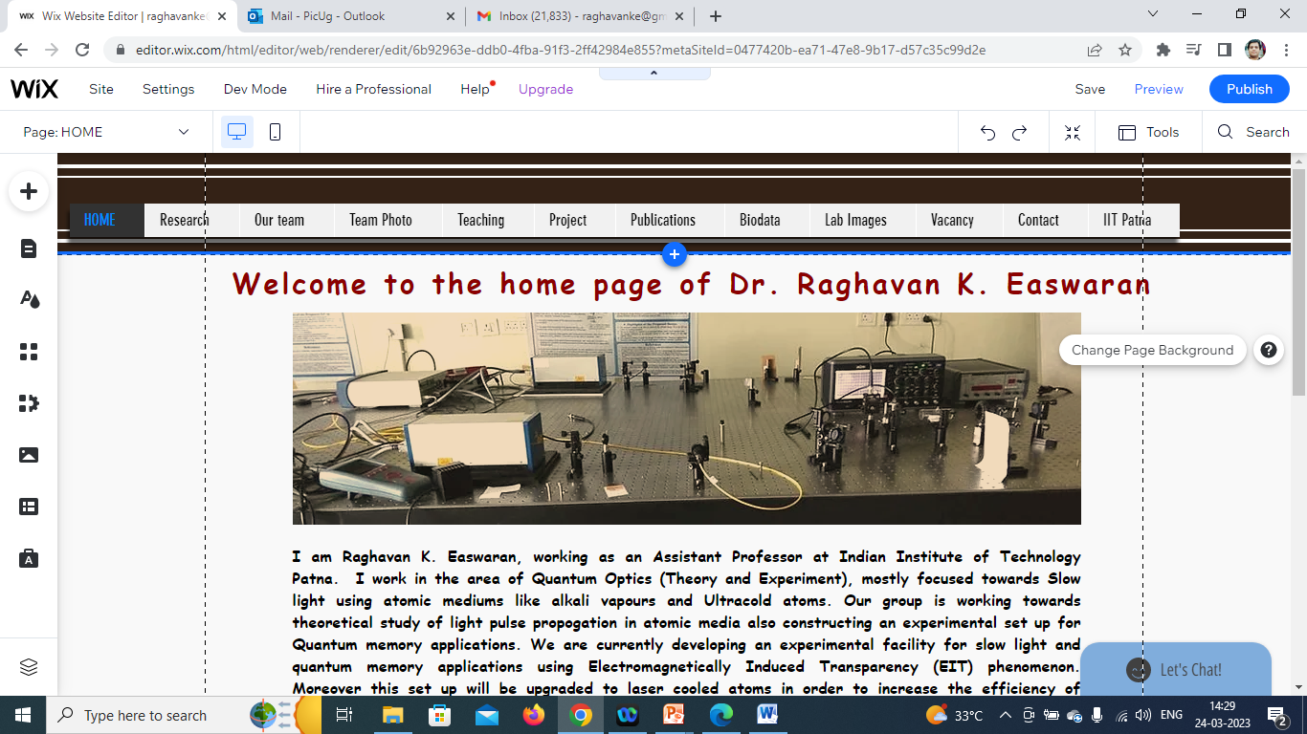
Research set up’s available
Research facilities developed at Optics Lab 1 (18B, Block 4)
1
2
Experimental set up
For saturation absorption
spectroscopy (SAS)
for Rb atoms
Experimental set up
For absorption
spectroscopy
for Rb atoms
3
4
Experimental
set up for
Multi window
EIT
Zeeman spectroscopy
For Rb atoms
5
Experimental
set up for EIT,
using structured
light etc

Slide 16
Research
Electromagnetically Induced Transparency
(EIT) in alkali vapor system (Exp and Theory)
1. Presence of Magnetic field
2. Effects of Structured light
3. EIT in Ultracold atoms
4. EIT in Engineered atoms
Quantum Technology
Slow light
Quantum Memory (QM)
Multiple frequency
EIT windows for
QM
Highly efficient EIT system for QM applications
Novel system for
Performing EIT and its applications
Very Narrow EIT window for ultra slow light
Quantum Memory, Quantum Information, Quantum Computers, Wireless Quantum communication, Quantum Repeaters etc

Slide 17
The system of choice for the development:
2D Magneto Optical Trap (2D MOT) using EIT protocol

Slide 18
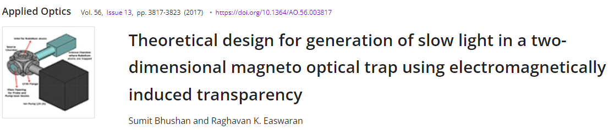
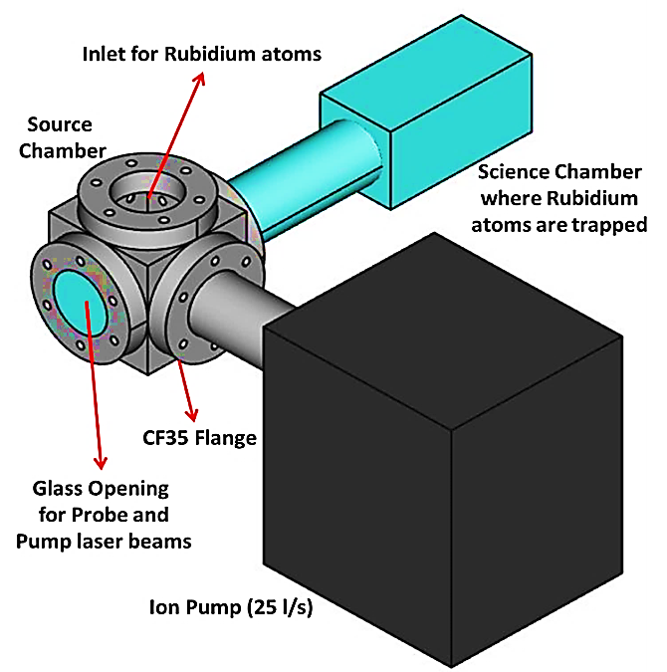
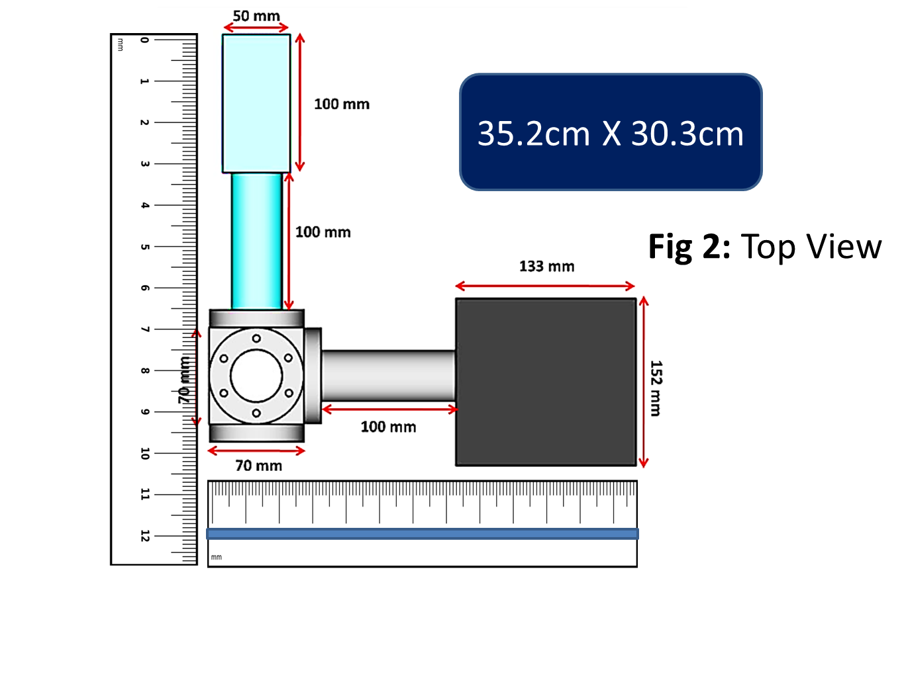
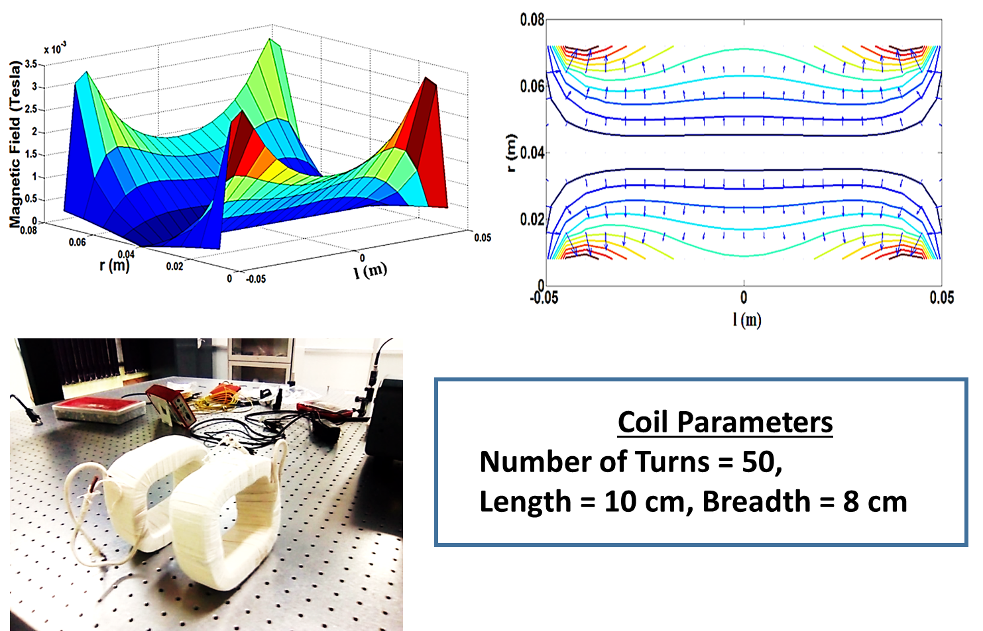
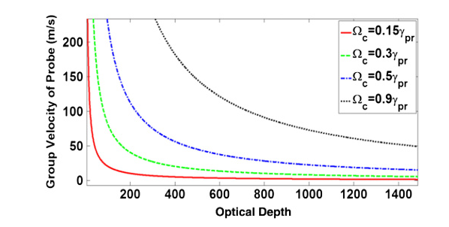
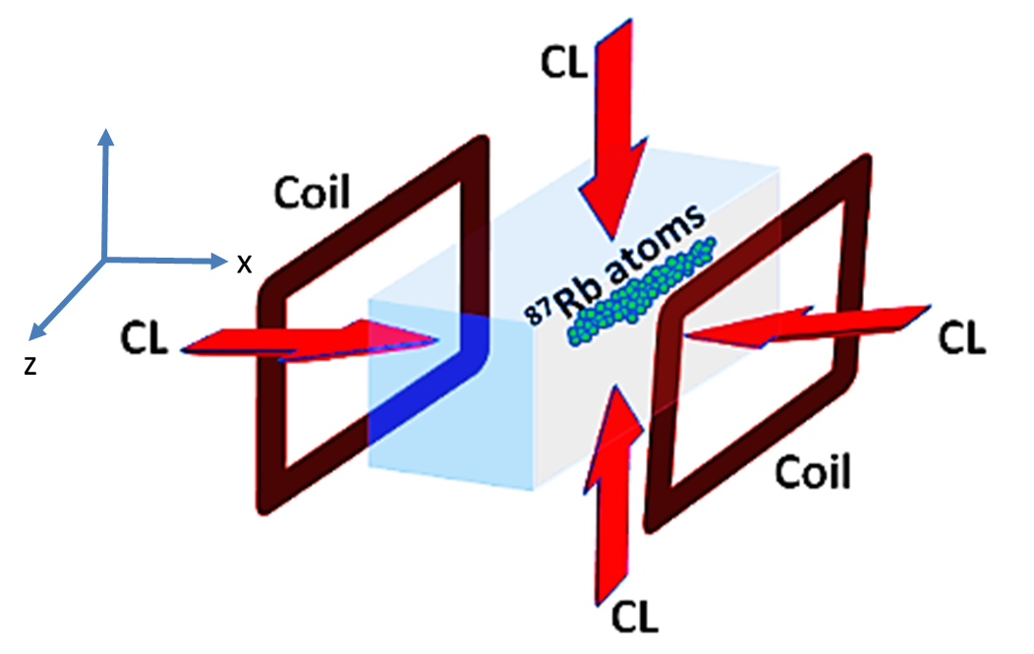
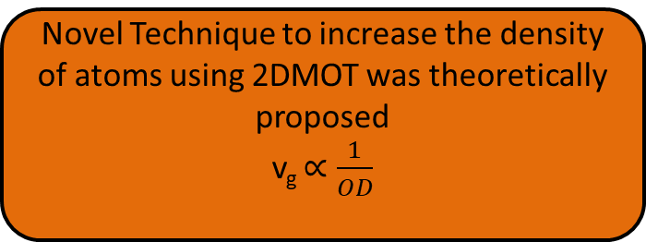
Novel Technique to increase the density of atoms using 2DMOT was theoretically proposed
v_{g} $∝\frac{1}{OD}$
3. EIT in Ultracold atoms
Ultra low group
Velocities
In 2D Magneto Optical Trap (2D MOT) using EIT
Novelty A novel technique for slow light experiments using EIT in a two-dimensional magneto optical trap. A compact 2D-MOT design efficient for quantum memory applications with adjustable optical depth (OD) is proposed. Based on the estimated OD (500) for setup, we found that light group velocities as lower than few m/s With our design, it is possible to obtain a delay bandwidth product of 163, which is very high in comparison to previously obtained values.

Slide 19
4. EIT in Engineered atoms
Title: Theoretical study on encapsulated Rb atom inside a C-60 cage for Quantum Technology
application using Electromagnetically Induced Transparency Protocol
Principal Investigator: Dr. Raghavan K . Easwaran
Duration: 3 years (2023) (Sanctioned)
Value: 26.97 Lakh
Funding Agency: SERB, CRG, DST, Govt of India
Breadth of my research work
QMs as nodes in QC (Technology aspect)

Slide 20
A
QM
QM
B

Slide 21
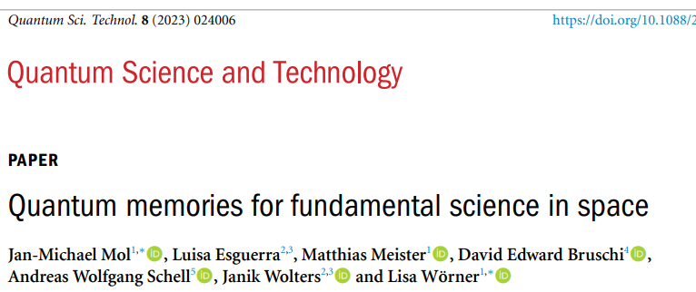
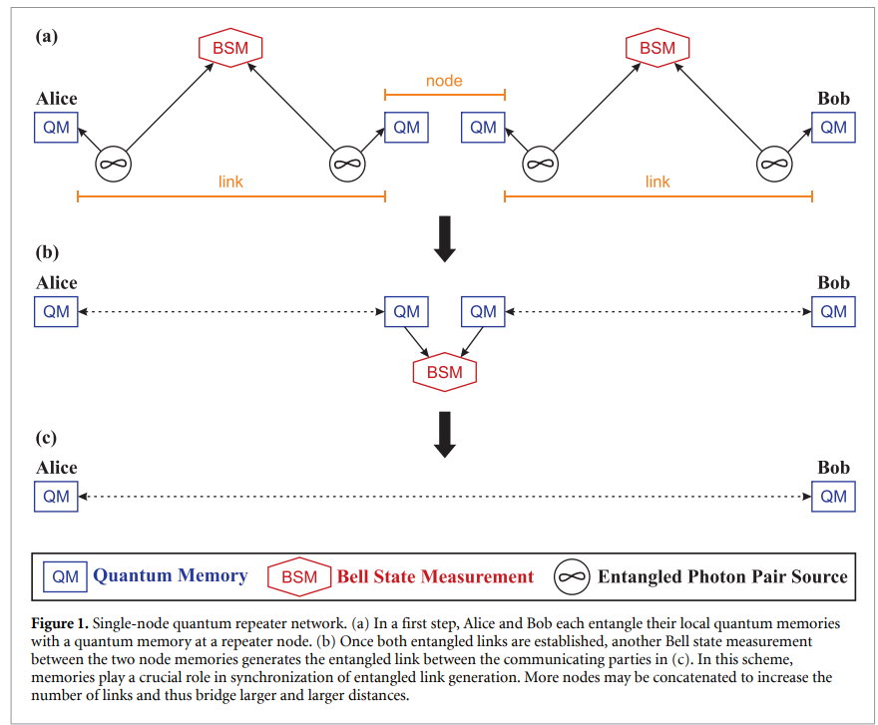

Slide 23
Need of Quantum Memory (QM) For Quantum Repeater (QR) node
QR is a platform where entanglement swapping occur’s and it must be simultaneous at all intermediate nodes in order to provide a link between two desired parties
As a synchronizer: QMs synchronize entanglement swapping between non-neighboring nodes, while Bell state measurement (BSMs) project photons into Bell states
In a quantum repeater scheme, photons arriving at Entanglement Swapper device must interfere.
To help achieve this, quantum memories can be used to store the quantum property of each photon until they are all available and ready, and then to release the photons in a controlled way onto the beam-combiner for more efficient interference.
Loss will change from exponential scale to polynomial scale
Work as a memory device for quantum entanglement Qubit

Slide 24
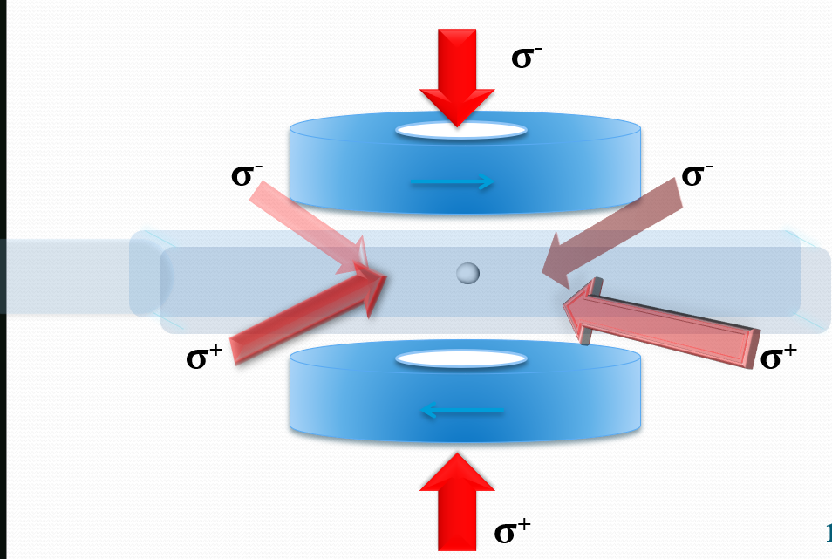
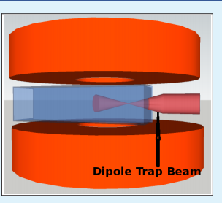
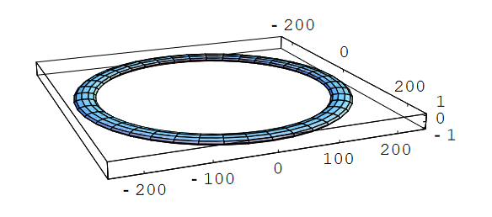
BEC
Cold atom- based sensors
v
Ring traps

Slide 25
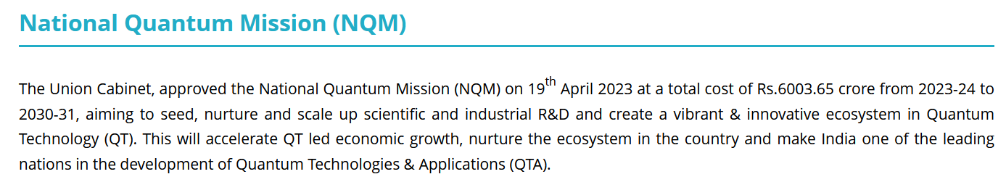
4. EIT in Engineered atoms
Title: Theoretical study on encapsulated Rb atom inside a C-60 cage for Quantum Technology
application using Electromagnetically Induced Transparency Protocol
Principal Investigator: Dr. Raghavan K . Easwaran
Duration: 3 years (2023) (Sanctioned)
Value: 26.97 Lakh
Funding Agency: SERB, CRG, DST, Govt of India
Research
Towards Quantum Technology
Ultracold atoms
Engineered atoms
Breadth of my research work
Proposal worth 12 crores approved (NQM)

Slide 26
Towards developing a Quantum Communication Network

Slide 27
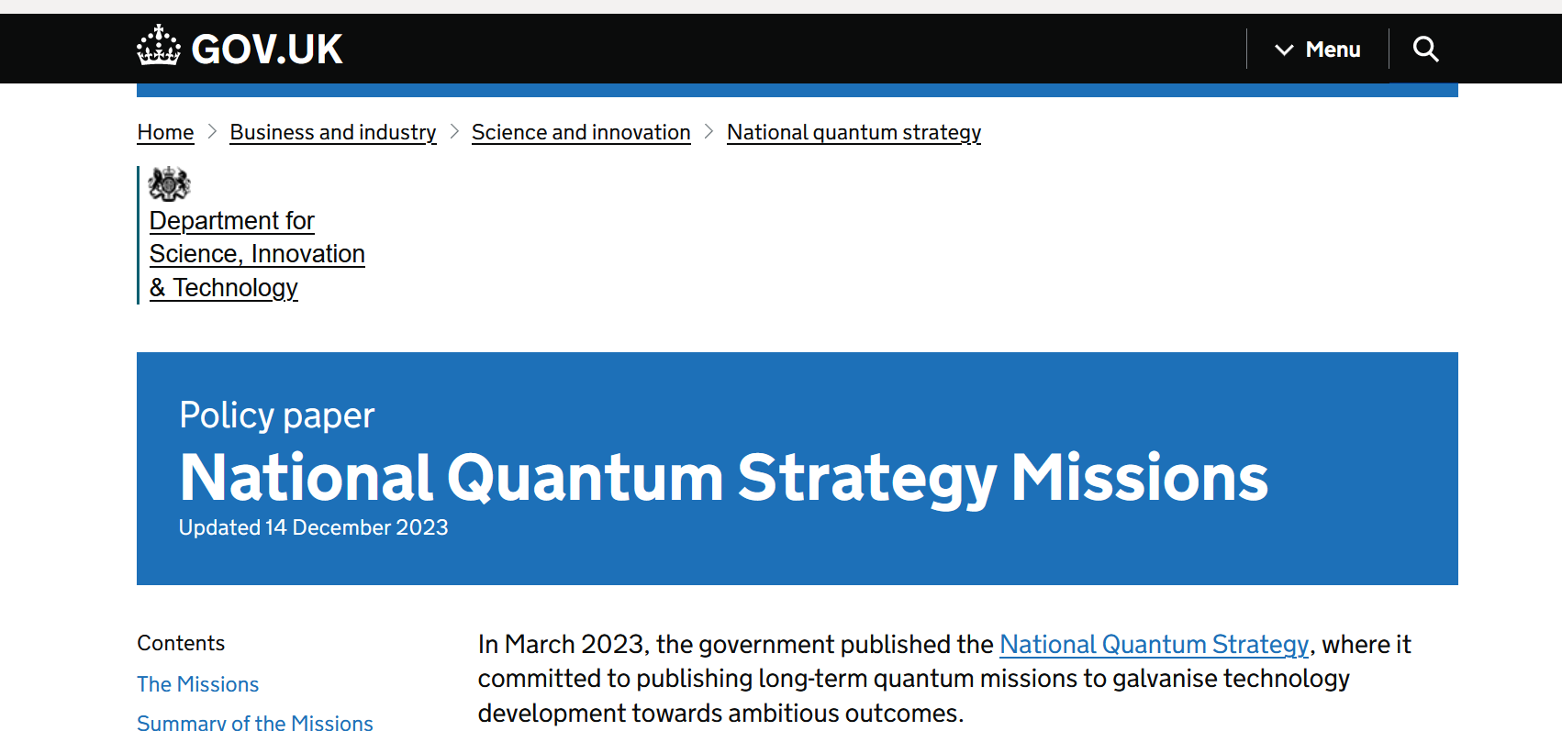
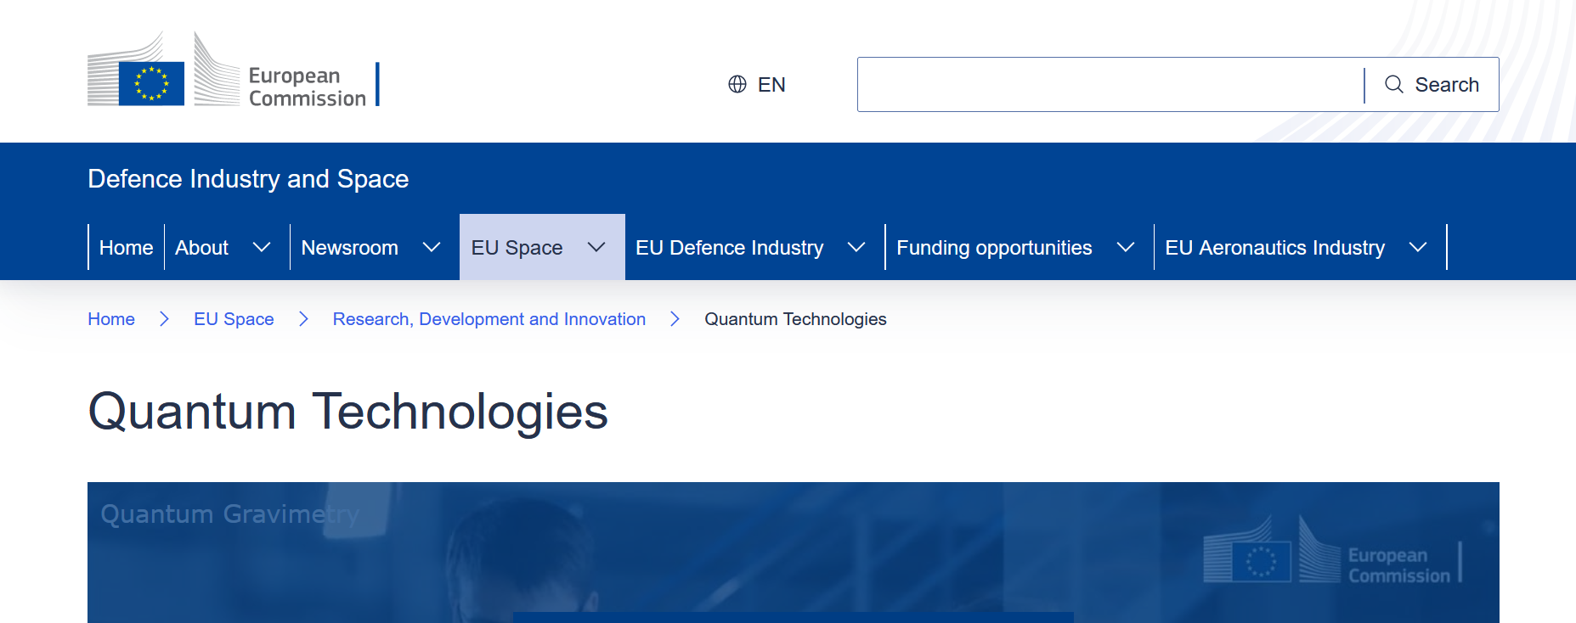


Europe, US, UK , Japan etc
Massive opportunity for future Employments in this sector

Slide 28

QM in Quantum Communication

