Slide 1
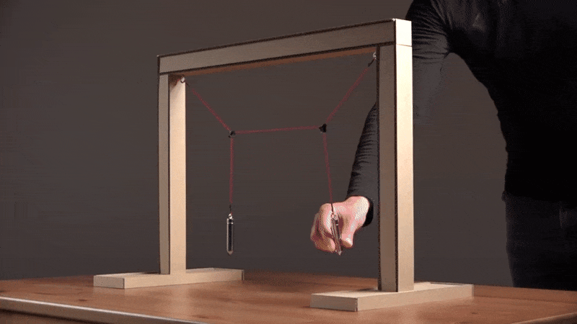
Coupled Oscillations

Slide 2
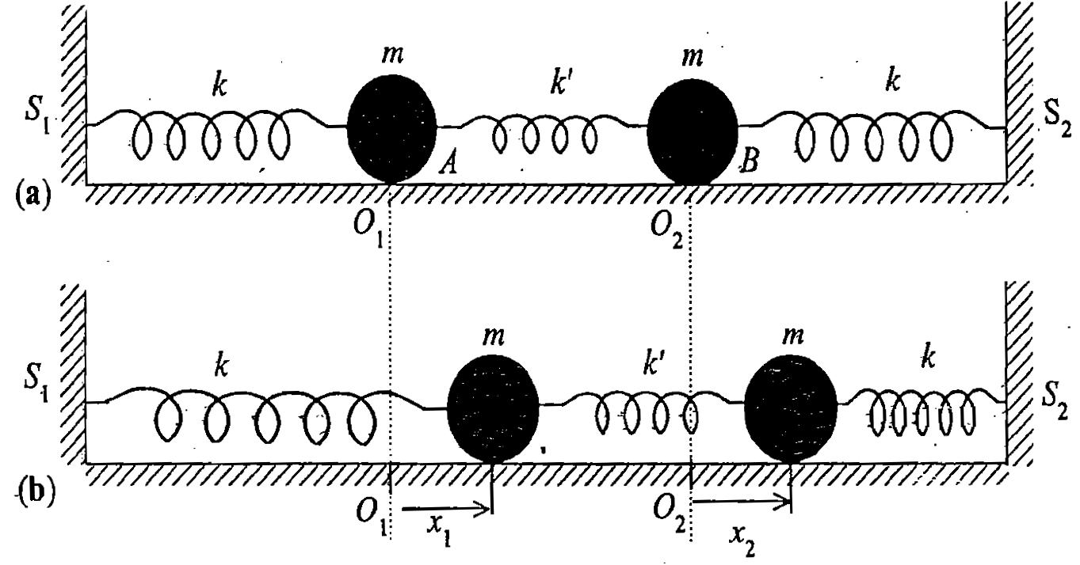
Coupled Oscillators
NON-INTITUTIVE!

Slide 3
Coupled Oscillators
Equations of motion are
Simultaneous coupled differential equation

Slide 4
Matrix equation of coupled oscillator

Slide 5
Trial solution

Slide 6
Following the procedure of getting Eigen values and Eigen vectors

Slide 7
Finding the energy eigen values λ of [A]

Slide 8
Finding an axis for which L is parallel to ω for the given [I]
RECOLLECT
IMPOSING THE CONDITION TO THE GIVEN [I]
BY IMPOSING THIS CONDITION AND FINDING THE UNKNOWNS λ AND ω GIVE INFORMATION ABOUT THE AXIS FOR WHICH L AND ω ARE PARALLEL FOR THE UNKNOWN RIGID BODY

Slide 9
Finding an axis for which L is parallel to ω for the given [I]
$$\left[I\right]ω − λω =0$$
$\left[\begin{aligned}2 −λ −1 \\ −1 2−λ\end{aligned}\right]\left[\begin{aligned}ωx \\ ωy\end{aligned}\right]$ = 0
Theorem: If [A][x]=0, then [A] is non-invertible. This implies A⁻¹ does not exist
Hence, |A|=0.
We can find relations btw $ωx$ and $ωy$
Characteristic Equation

Slide 10
Finding Eigen values of [A]

Slide 11
Characteristic equation:
Eigen values of [A]

Slide 12
Eigen values of [A]

Slide 13
Find the eigen vectors of [A]

Slide 14
Finding an axis for which L is parallel to ω for the given [I]
RECOLLECT
λ_{1,} λ₂ are called the Eigen values which satisfies the equation
[ω]’s are called the Eigen vectors.
For each Eigen values, Eigen vector can be found.

Slide 15
Finding Eigen vectors of [A]
Substitute each values of α² in the Eigen value equation
Putting α₁² in the Eigen value equation to get first set of
Eigen vectors

Slide 16
Substituting

Slide 17
Substituting

Slide 18
Finding Eigen vectors of [A]
Substitute each values of α₃² in the Eigen value equation
Putting α₃² =-(ω₀²+2ω_{c}² ) in the Eigen value equation

Slide 19
Substituting

Slide 21
S
U
M
M
A
R
Y

Slide 23
Let’s recapitulate……

Slide 24
(Underdamping)
RECOLLECT
Mathematically this gives a complex solution!
A and B also could be complex!
But position x(t) cannot be complex!
Is there any real solution?
Solution can be made real by choosing
appropriate constants

Slide 25
RECOLLECT
Need to make it real and get the form of familiar Harmonic Oscillator
How to do it?

Slide 26
How to do it?
We get A and B as
REAL x(t)

Slide 27
REAL SOLUTION FOR UNDER DAMPED
HARMONIC OSCILLATOR
NO Damping here

Slide 29
Oscillations to Waves
RECAP

Slide 30
What we did?

Slide 32
=
+

Slide 33
Plots: Amplitude v/s time
x₁(t) v/s t
x₂(t) v/s t

Slide 34
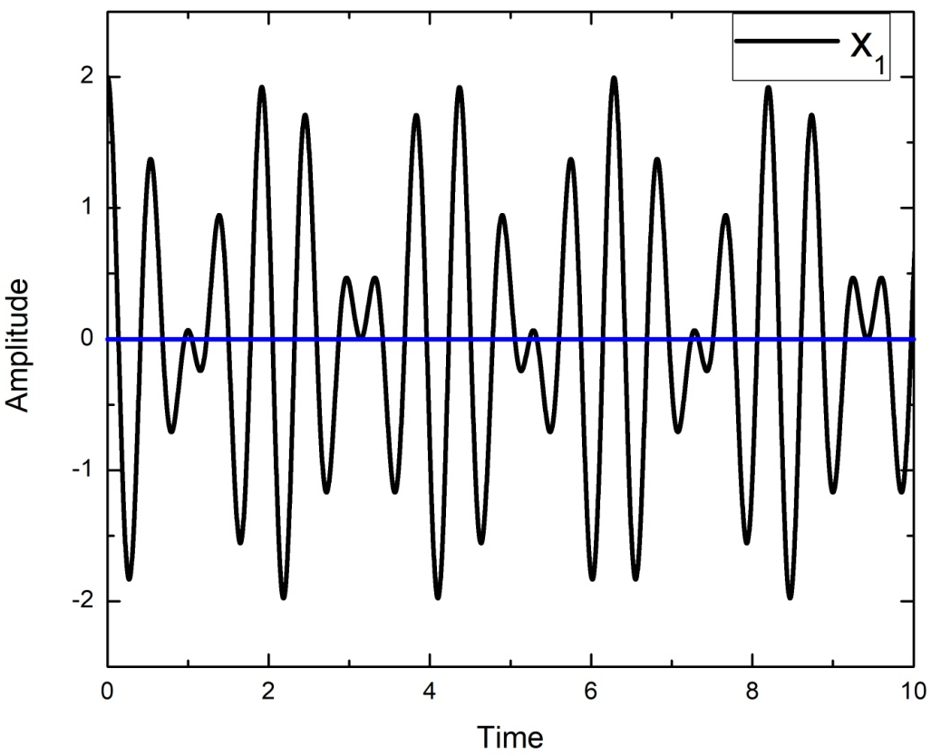
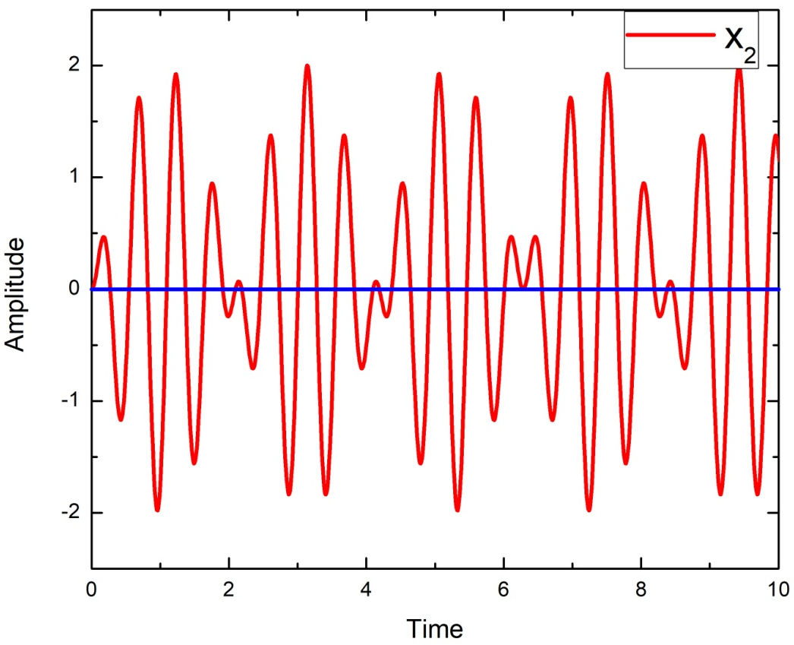

Slide 35
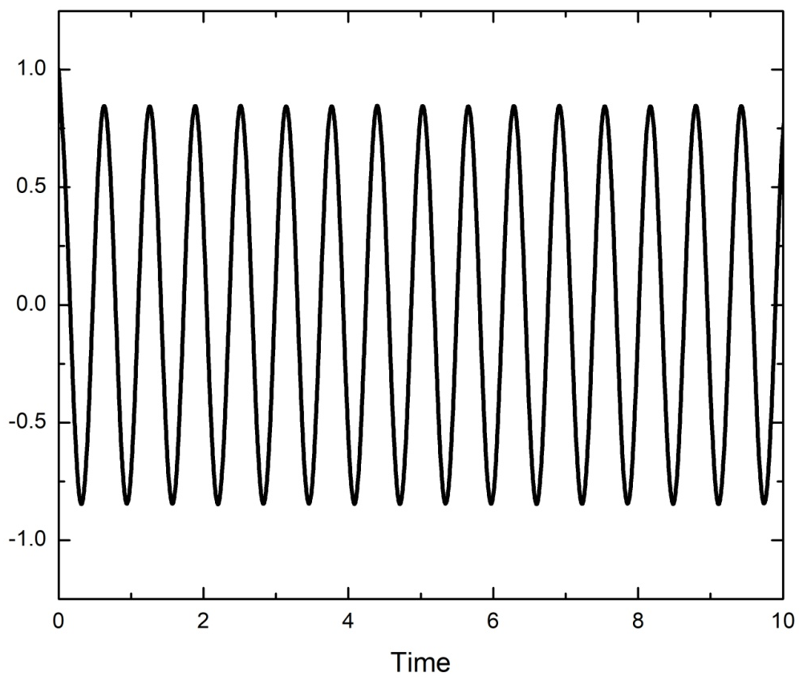
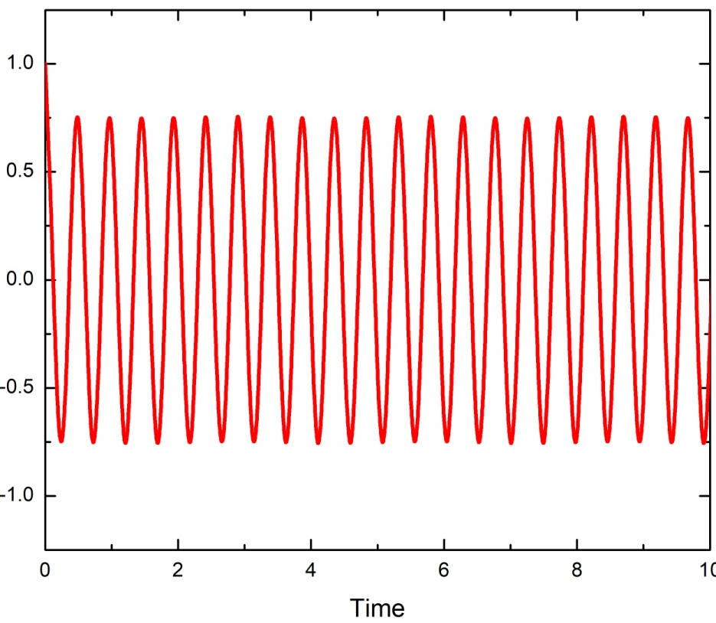

Slide 36
Normal Coordinates
Can we get some co-ordinates which will oscillate with one pure frequency??
Try by just adding x₁ and x₂ and subtracting
x₁ and x₂

Slide 37
Normal Coordinates
Inverse transformation

Slide 38
Why Normal Co-ordinates?
This will help in knowing 2 different frequencies independently
If you plot X₁(t) and X₂(t) v/s time you get nice cosine graph
x₁(t) and x₂(t) v/s time was erratic in nature
Out of phase and in-phase motion cannot get visualized though!

Slide 39
Is there any alternative way of solving the coupled differential equation?

Slide 40
Alternate way of deriving….
Equations of motion are
Simultaneous coupled differential equation

Slide 41
Equations of motion are
…….. (1)
…….. (2)
(1)+(2)
(1)-(2)

Slide 42
…….. (3)
…….. (4)
BACK TO NORMAL CO-ORDINATES AND NORMAL MODES

Slide 43
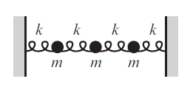
2
D
I
S
C
R
E
T
E
TO
C
O
N
T
I
N
O
U
S
P
L
A
N
3
.
.
.
N
∞

Slide 44
3-masses coupled oscillator

Slide 45
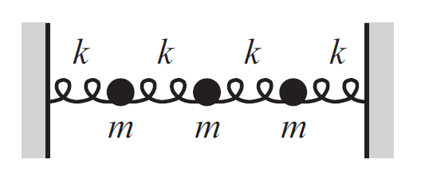
3-masses coupled oscillator
x₁
x₂
x₃

Slide 46
3-masses coupled oscillator

Slide 47
T
U
T
O
R
I
A
L
3
EIGEN VALUES = 3 NORMAL MODES
&
3
EIGEN VETORS
Characteristic equation
Eigen values and Eigen vectors
Normal modes and Normal co-ordinates

Slide 48
Solving eigen values and eigen vectors for n-Coupled mass system

Slide 49
n-masses coupled oscillator
What will be the equation of motion for i^{th} mass?
Recollect

Slide 50
N-masses coupled oscillator
What will be the equation of motion for i^{th} mass?

Slide 51
Solving n coupled masses equation
will have n values
hence n normal modes will be present
ω
will
Have
n
values

Slide 52
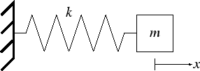
Few scattered thoughts on oscillations leading to waves
One Normal mode & One resonance frequency
Two Normal modes and therefore two resonance frequency
Any motion of the masses can be represented by a linear combination of two modes!

Slide 53
Few scattered thoughts on oscillations leading to waves
N Normal modes and therefore
N resonance frequencies
Any oscillatory motion of the masses can be represented by a linear combination of N orthogonal modes!

Slide 54
Oscillations to Waves
How are they related?

Slide 55
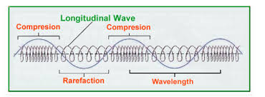
Oscillations to Waves
How are they related?
A wave can be thought of as a disturbance or oscillation that travels through space-time, accompanied by a transfer of energy.
If the direction of wave propagation is parallel to the direction it oscillates then its called as Longitudinal waves.
Longitudinal waves generated in a coupled oscillator
A wave does not move mass in the direction of propagation; it transfers energy.

Slide 56
Longitudinal waves

Slide 57
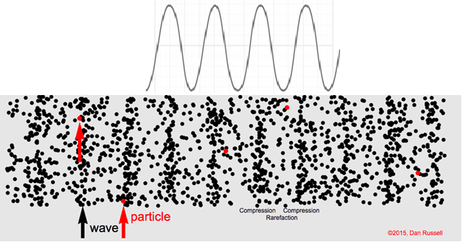
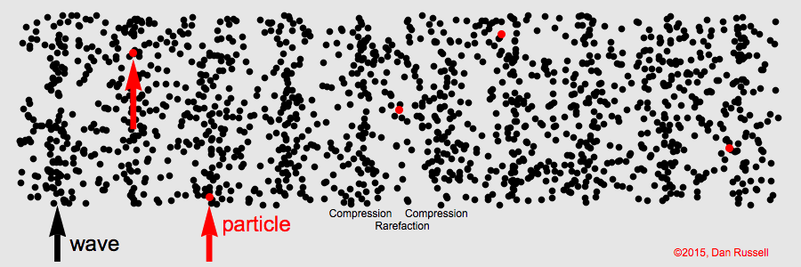
Longitudinal waves

Slide 58
Oscillations to Waves
Longitudinal waves could be generated in a coupled oscillator
An external driving Impulse can generate a disturbance
to n coupled Oscillator
For efficient energy transfer driving impulse frequency should be matched with
normal frequency/normal modes
Looking for space dependence of amplitude!
$$\left.S(x,t\right)$$

