Slide 1
Practice Problems

Slide 2
Plots of
Analysis of Critically damped oscillator

Slide 3
Plot 1
Given

Slide 4
Zero crossing:
For the oscillator to cross equilibrium at finite time t >0, A or B has to be negative.
A = 10, B = 4, t_{c} is negative, hence system
will not cross equilibrium in positive value of t

Slide 5
Maxima /Minima:
Maximum

Slide 6
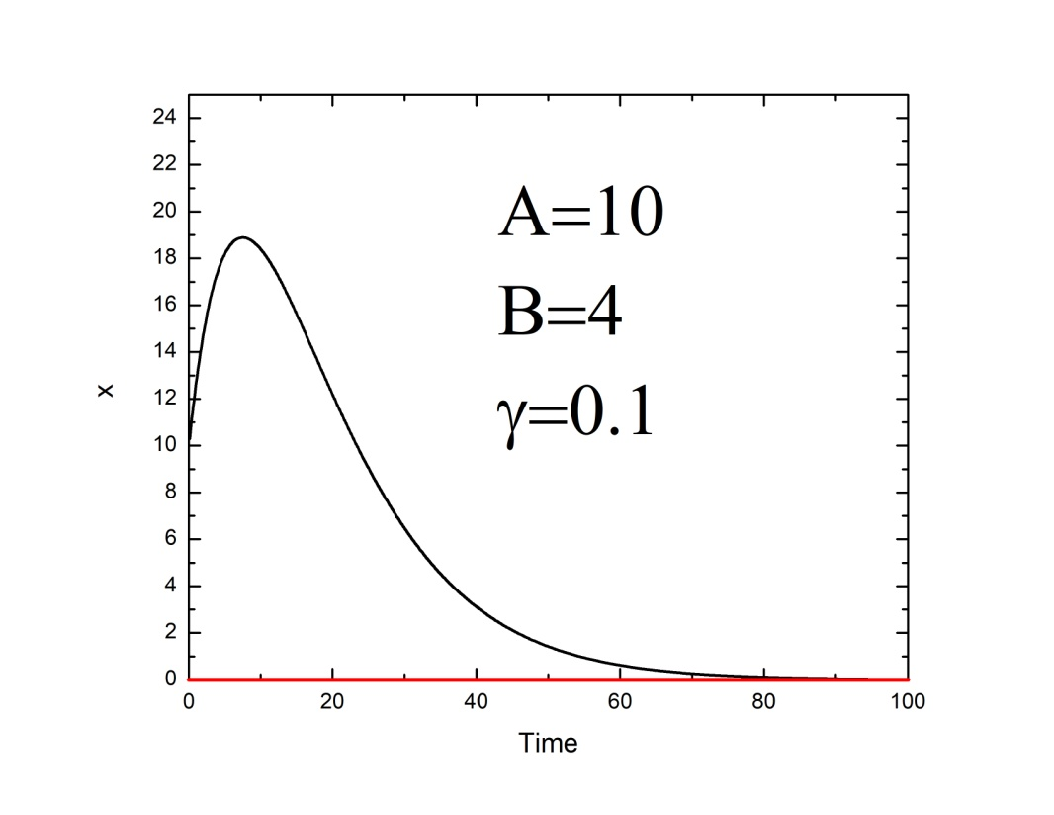
Maximum at 7.6s

Slide 7
Plot2

Slide 8
Zero crossing:
For the oscillator to cross equilibrium at finite time, A or B has to be negative.
A = -10, B = 2, t_{c} is positive, hence system
will cross equilibrium in positive value of t

Slide 9
Maxima /Minima:
Maximum

Slide 10
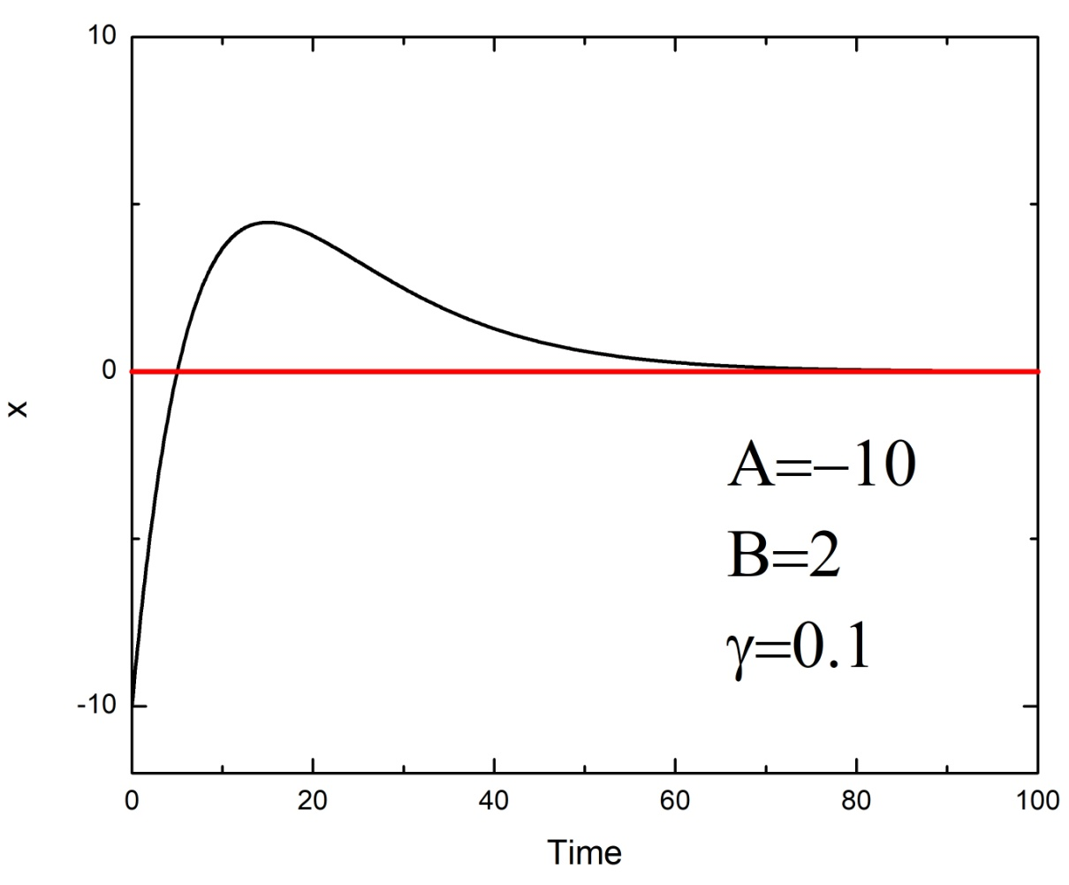
Maximum at 15s

Slide 11
Plot 3

Slide 12
A = -40, B = -1, t_{c} is negative, hence system
will not cross equilibrium in positive value of t
Zero crossing:
Maxima/Minima:

Slide 13
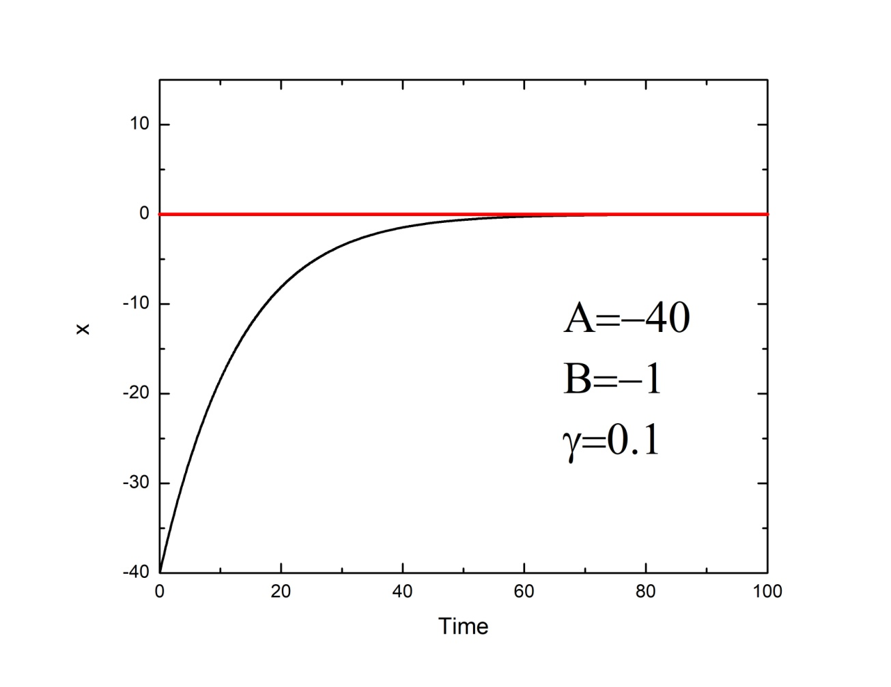

Slide 14
Plot 4

Slide 15
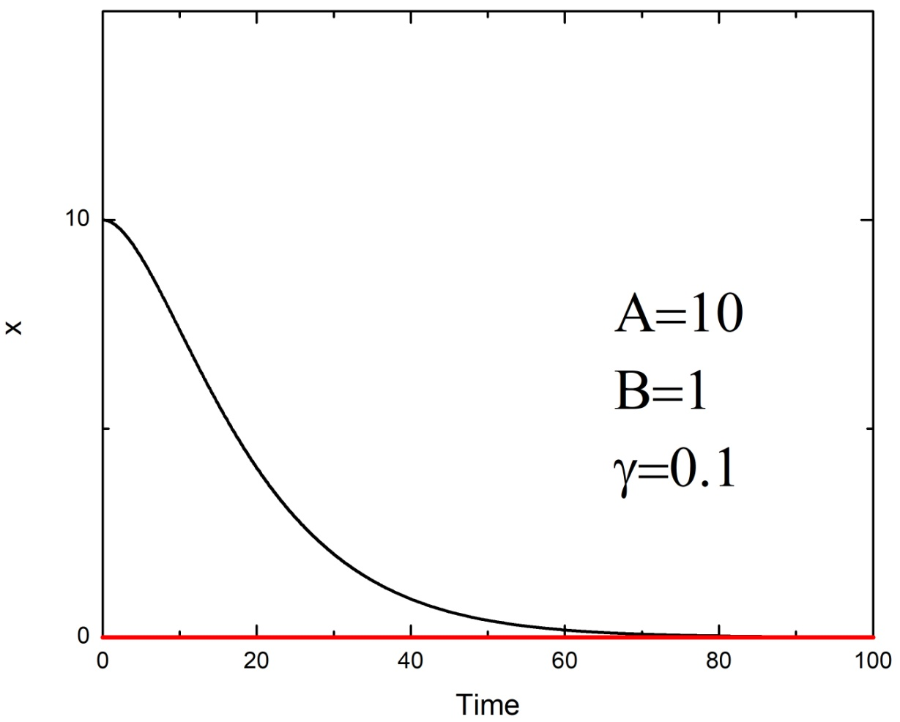
A=40

