Slide 1
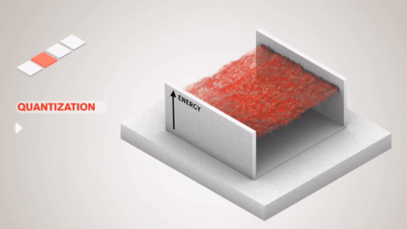
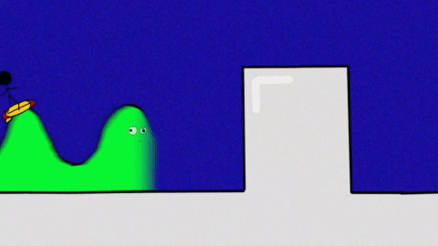
Quantum Physics- A final touch

Slide 2
Some concerns on free particle and
variable separable method
Why it is equated to a constant?
Mathematical:
E(t)
E(x)
LHS (A time dependent differential equation ) = RHS (A position dependent differential equation)
This can be possible only if this is equal to a constant
Physical:
This equation is of Total Energy hence must be a constant

Slide 3
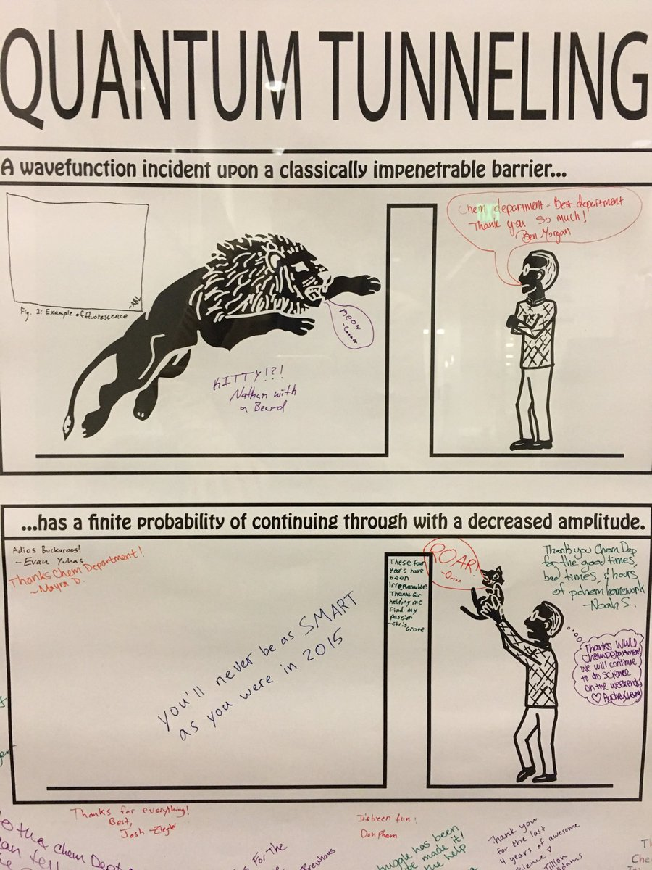
Today’s Plan
1
2
3
C
O
N
C
L
U
D
I
N
G
Are you kidding?

Slide 4
Recap: Schrödinger Equation
Schrödinger equation.
Time independent Schrödinger equation.

Slide 5
1
Particle in an impenetrable box
Are you kidding?

Slide 6
Consider a quantum mechanical particle trapped inside an impenetrable box of length L.
(a) Write the schrödinger equation for the system.
(b) Obtain the energy from boundary condition .
(c) Plot the energy diagram.
(d) Obtain the wavefunction by solving the Schrodinger equation.
(e)Normalize the wavefunction and plot the ψ(x) and |ψ(x)|².

Slide 7
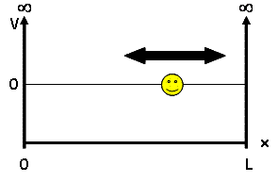
Solve the Schrödinger’s equation subjected to Boundary Conditions

Slide 8
Apply the Boundary Condition-1
Apply the Boundary Condition-2

Slide 9
n=1,2,3,….

Slide 10
(c) Plot the energy diagram.

Slide 11
Quantized energy levels

Slide 12
n=1,2,3,….

Slide 13
(d) Plot the wavefunction

Slide 14
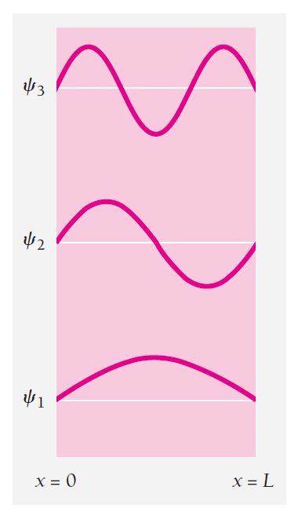

Slide 15
(e) Normalize and Plot the probability density

Slide 16
Normalize the ψ(x)
C²
=1
C²
=1

Slide 17
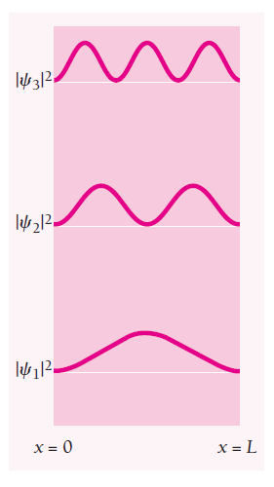

Slide 18
Expectation value of position

Slide 19
Expectation value of momentum
Guess why?

Slide 20
Particle in a box

Slide 21
Quantum Tunneling
2

Slide 22
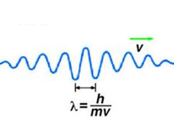
Case 1: E>U
e
Total Energy
U
I
II
III
Position

Slide 23
Case 2: E<U
Total Energy
U
e
I
II
III
Position

Slide 24
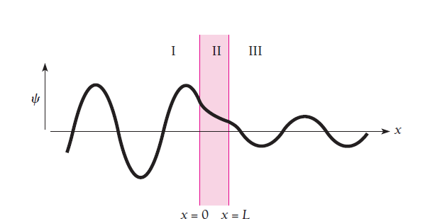
Case 2: E<U
U
Total Energy
e
I
II
III
Position
Effect of Tunneling!

Slide 25
Quantum Tunneling

Slide 26
Quantum Tunneling

Slide 27
Kronig-Penny Model
How electrons move inside a crystal lattice…………..

Slide 28
Topics Covered after mid sem/ Topics for end Sem
Rigid body in motion
Oscillations and Waves
Quantum Physics
All the lectures and tutorials updated in course webpage: //www.raghavanke.com//

Slide 29
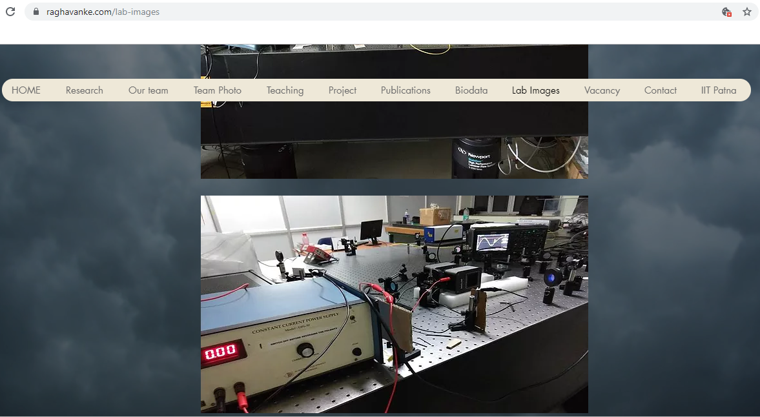
Quantum Physics
Applications every where….
Slow Light, Quantum Optics, Quantum Information in my group at IIT Patna… Block 4, Ground floor Optics1 lab

Slide 30
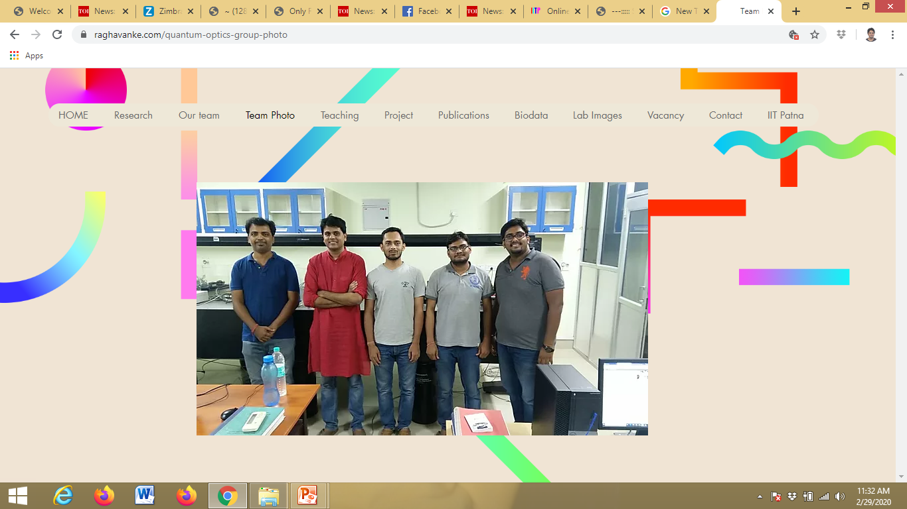
3 PhD’s on going…..
Currently Post Doc @
National Institute of Standards and Technology (NIST)
Maryland
USA
Sumit Bhushan
Vikas – Synopsis over

Slide 31
Research Internships

Slide 32
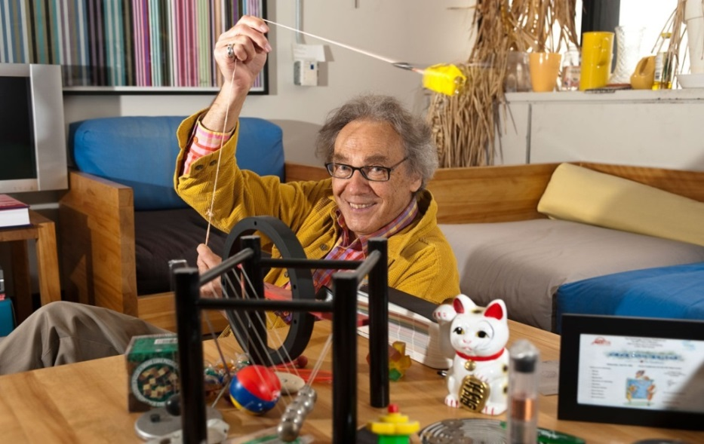
“What counts, I found, is not what you “cover”, in a class, but what you “uncover”
covering subjects in a class can be a boring exercise, and students feel it
uncovering the laws of physics and making them see through the equations, with all its newness and excitement, and students love being part of it.” ― Dr. Walter Lewin, Professor, MIT, USA
Good Luck, All the best!

