Slide 1
Season 1, Lecture 15 (S1,L15):
Recap/Tutorial 5

Slide 2
Tutorial 5
Second Law

Slide 3
Convert P-V diagram of Carnot Cycle to T-S diagram also calculate efficiency using T-S diagram
1
isothermal
2
Q_{in}
1
2
T
P
Q=0
T_{hot}
Q=0
adiabatic
adiabatic
T_{cold}
4
3
Q_{out}
isothermal
4
3
S
V

Slide 4
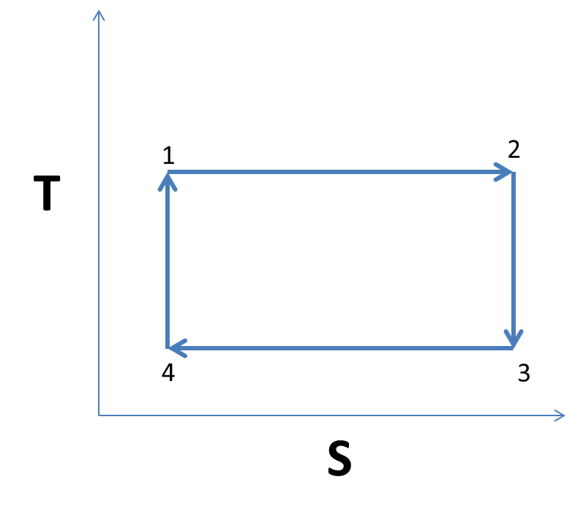

Slide 5
1 to 2 to 3 to 4 to 1
3
P
adiabatic
2
4
adiabatic
1
V

Slide 6
1 to 2 to 3 to 4 to 1
3
P
adiabatic
2
4
adiabatic
1
V
T
2
1 to 2
1
S

Slide 7
1 to 2 to 3 to 4 to 1
3
P
adiabatic
2
4
adiabatic
1
V
3
2 to 3
2
T
1
S

Slide 8
1 to 2 to 3 to 4 to 1
3
P
adiabatic
2
4
adiabatic
1
V
3
3 to 4
T
2
4
1
S

Slide 9
1 to 2 to 3 to 4 to 1
3
P
adiabatic
2
4
adiabatic
1
V
3
3 to 4
T
2
4
1
Using
S

Slide 10
1 to 2 to 3 to 4 to 1
3
P
adiabatic
2
4
adiabatic
1
V
3
3 to 4
T
2
4
1
S

Slide 11
1 to 2 to 3 to 4 to 1
3
P
adiabatic
2
4
adiabatic
1
V
3
3 to 4
T
2
4
1
S

Slide 12
1 to 2 to 3 to 4 to 1
3
P
adiabatic
2
4
adiabatic
1
V
3
3 to 4
T
2
4
1
S

Slide 13
1 to 2 to 3 to 4 to 1
3
P
adiabatic
2
4
adiabatic
1
V
3
4 to 1
T
2
4
1
S

Slide 14
3
3
P₃
P
Adiabatic
P₂
1
2
V₂
V
V₁

Slide 15
1 to 2
2 to 3

Slide 16
3 to 1
Adiabatic
Also

Slide 17
S

Slide 18
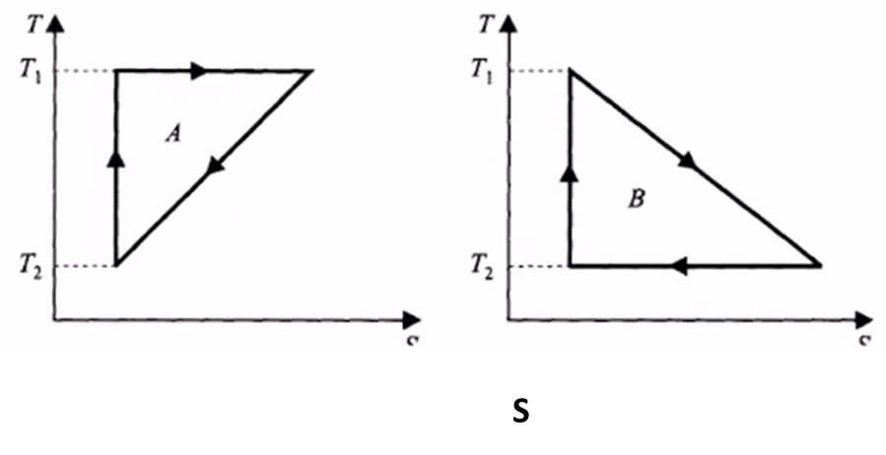
Isothermal expansion
3
2
Adiabatic
1
S1
S2

Slide 19
Roll No | Name | P/A
2101PH03 | ABHINAV T V | a
2101PH05 | AMAN KUMAR | p
2101PH06 | AMAR KUMAR | p
2101PH07 | AMOY ASHESH | p
2101PH08 | ANIKET RAJ | p
2101PH09 | ANIKET SAWATE | a
2101PH11 | ARYAN SINGH SISODIYA | a
2101PH12 | AYESHA KHAN | a
2101PH13 | AYUSH SINGH | a
2101PH16 | TANISHK KADAM JEEVAN | p
2101PH17 | KANISHK SINGH SOLANKI | p
2101PH19 | MEESALA MAHESH | p
2101PH21 | N AJAY | p
2101PH22 | NITISH KUMAR | p
2101PH24 | RAJAT CHANDNA | a

Slide 20
Roll No | Name | P/A
2101PH27 | S RAMAKRISHNA | a
2101PH28 | SALOCHANA | p
2101PH29 | SANJANA KUMARI | a
2101PH30 | SHILPA KANJILAL | p
2101PH32 | VISHESH SAHU | a
2101PH18 | Elisha Joel | p
2101PH14 | Pavan | a
2101PH04 | Abhishek Shaw | p
2101ph15 | Chandan Kumar | a

