Slide 1
Highlights of the course
Co-ordinate Systems
Introduction to Vector Operators
Work , Energy and Conservation laws
Rigid body in motion
Oscillations and Waves
Quantum Physics

Slide 2
1. Co-ordinate Systems
(Continued…)
Choice of Co-ordinate systems
Cartesian Co-ordinates: Line, area and volume element
Plane-Polar Co-ordinates: Unit vectors, transformations, Rate of change, velocity and acceleration,
Line element, area element
Cylindrical Co-ordinates: Unit vectors and its transformations, Rate of change, velocity and acceleration, line, area and volume element
Spherical Polar Co-ordinates: Unit vectors and its transformations, Rate of change, velocity and acceleration, line, area and volume element
Lec 1-3
&
Tut1

Slide 3
Elemental area in polar coordinates
Y
Elemental area:
Area of Circle
X

Slide 4
Area of a circle of radius R
r

Slide 5
Cylindrical Coordinate System
Z
X
Y

Slide 6

Transformation of unit vectors
Z
Z
-
$\hat{e}$_{Ф}
X
Y

Slide 7
Derivatives of unit vectors
Z
X
Y

Slide 8
Infinitesimal line element
Z
P₂
X
P₁
Y

Slide 9
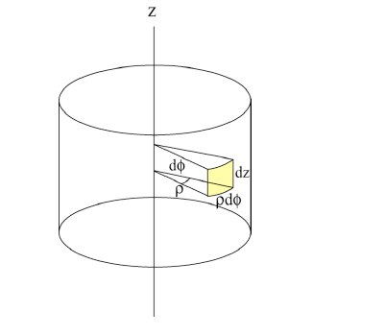

Infinitesimal area element

Slide 10
Infinitesimal Volume element

Slide 11
Volume of cylinder
Z
R
H
X
Y

Slide 12
Velocity in cylindrical polar co-ordinates

Slide 13
Acceleration in cylindrical polar co-ordinates

Slide 14
Plane polar
Cylindrical polar

